Slide 1
Enhanced Geothermal System Sensitivity Study
By: Benjamin Willis

Slide 2
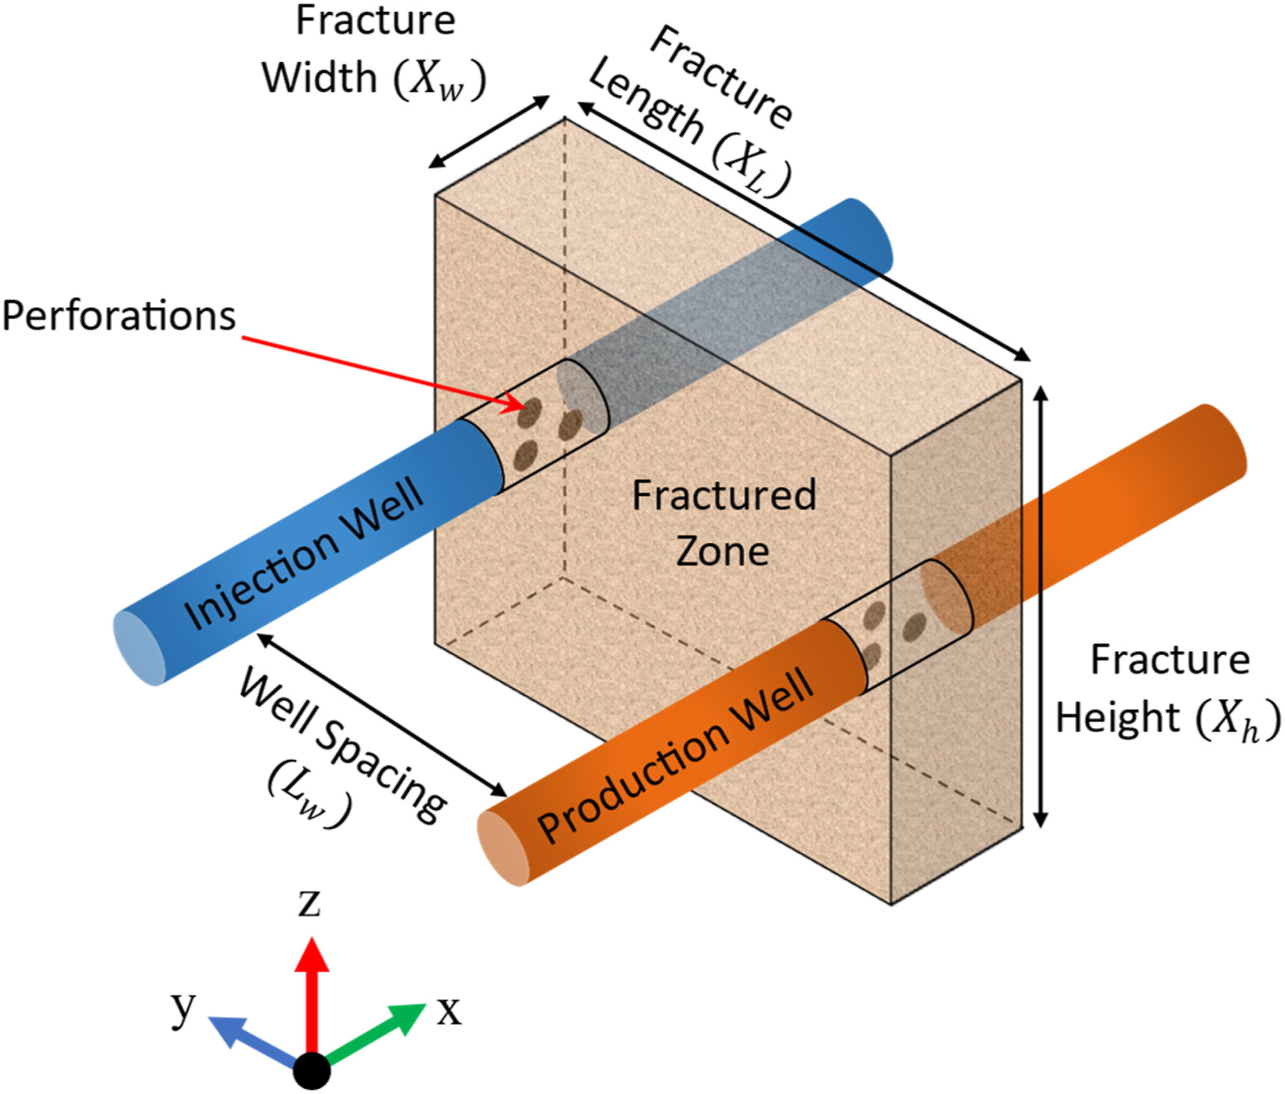
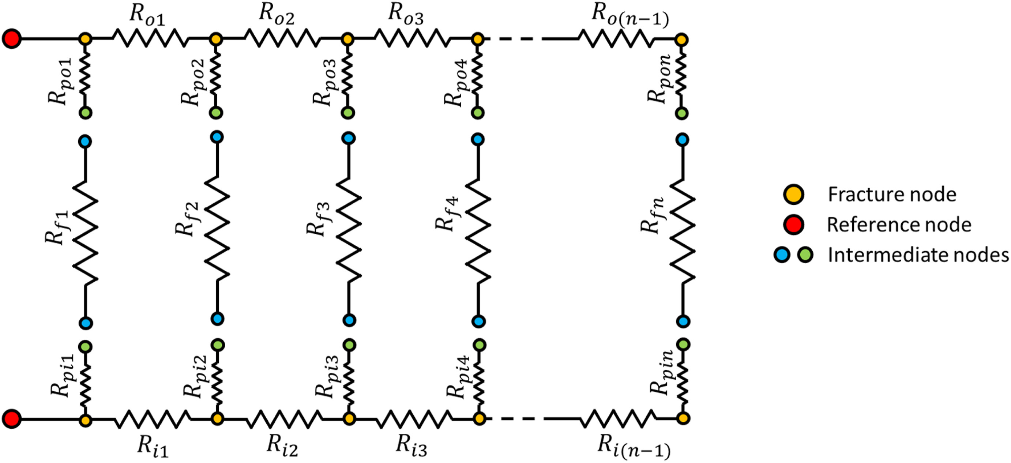
Introduction to EGS Sensitivity Studies
The analytical model parameters were set to resemble the parameters of the Utah FORGE site.
Circuit Diagram used to solve EGS system

Slide 3
Introduction to EGS Sensitivity Studies
Goal: Use analytical model to test sensitivity of Utah Forge EGS model
Compare: Parallel and Non-Parallel Well Designs
First study: Varying Number of Perforations (1-100)
Second study: With and Without Exit Perforations
Third study: Varying Inlet Flowrate (5 to 50 kg/s)
Fourth Study: Varying Fracture Permeability (1e-12 m² or 1e-14 m²)
Fifth Study: Varying Well Angle (Non-Parallel Design)
Sixth Study: Varying Number of Fractures with 1 Inlet Perforation

Slide 4
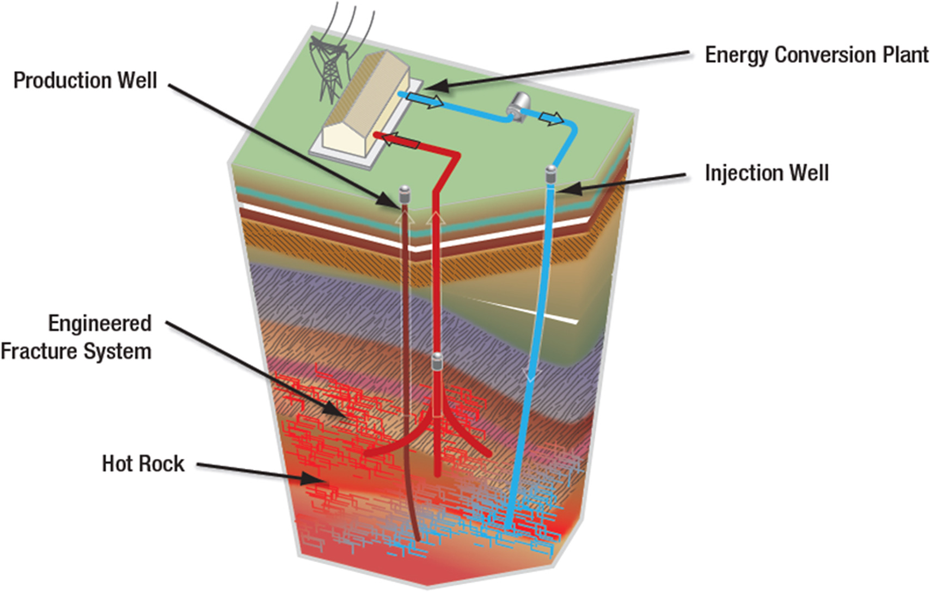
First Study, Second Study, And Third Study
Varying Number of Perforations (1-100)
With and Without Exit Perforations
Varying Inlet Flowrate (5 to 50 kg/s)

Slide 5
Analytical Model Parameters
Permeability | 1e-12 m²
Number of Fractures | 3
Mass Flow rate | 5 to 50 kg/s (steps of 5 kg/s)
Water Density | 1000 kg/m³
Gravity Constant | 9.8 m/s²
Discharge Coefficient | 0.75
Injection Pressure | 3*10⁷ Pascals
Total Well Length | 3227 m
Roughness of Pipe | 1.5*10⁻⁵ m
Fracture Height | 100 m
Fracture Width | 5 m
Base Fracture Length | 100 m
Diameter Injection/Production Pipes | 0.18 m
Number of Perforations | 1 to 100 (steps of 1)
Base Diameter of Perforations | 0.009525 m (3/8 in)

Slide 6
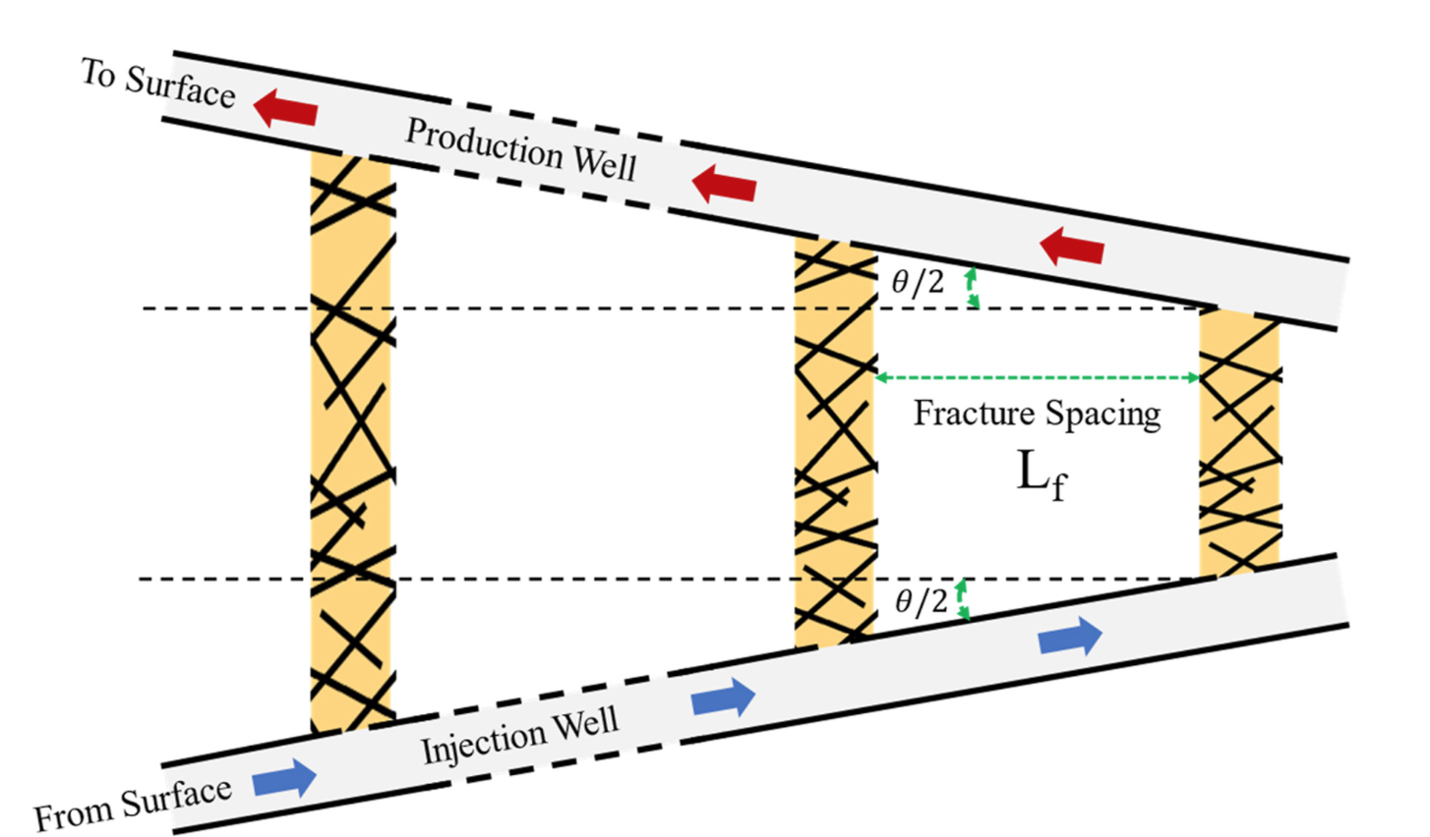
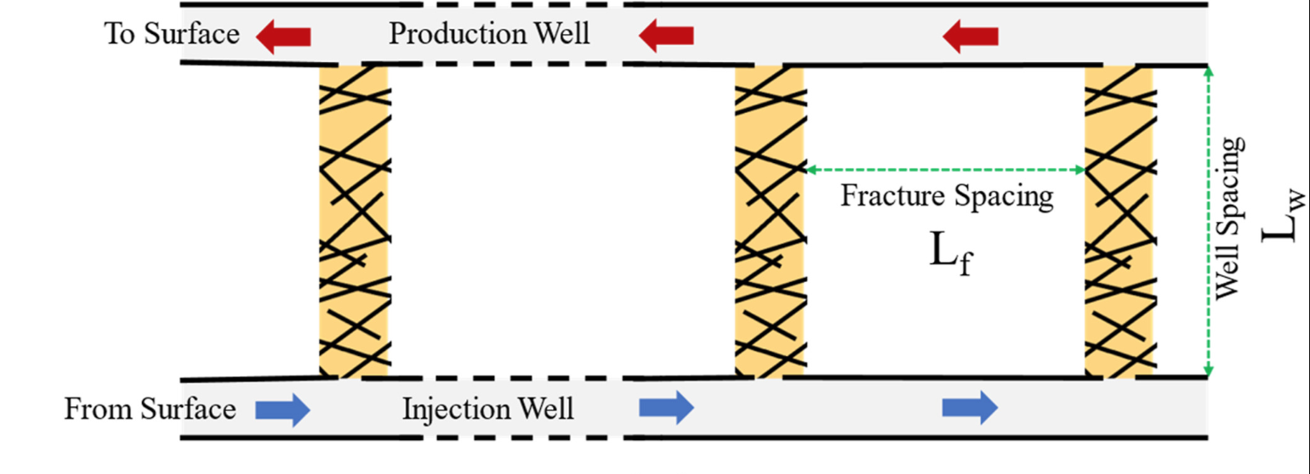
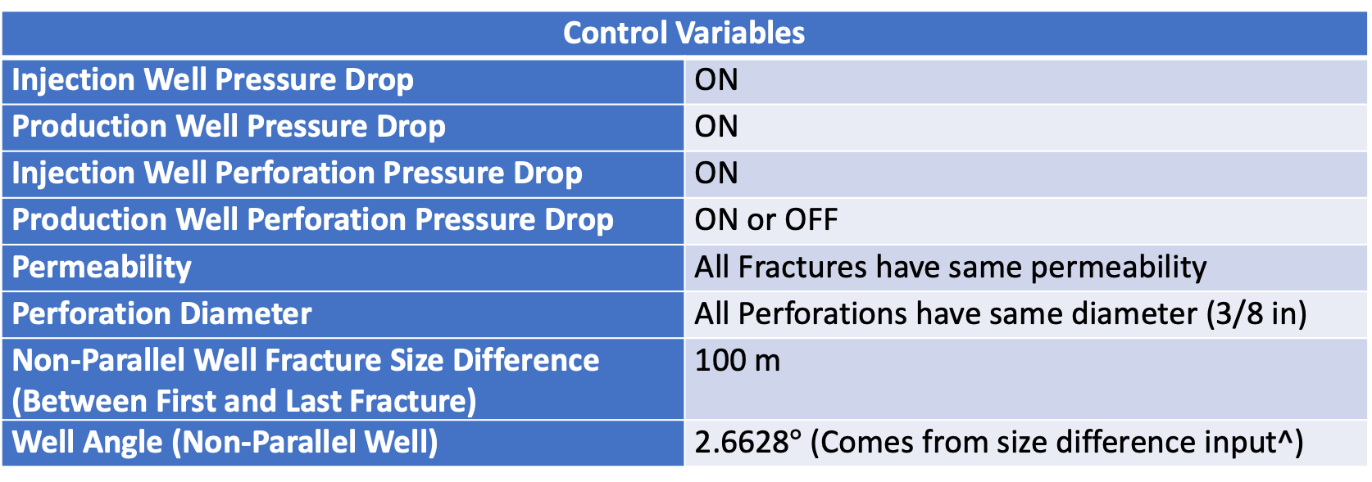
Control Variables
Injection Well Pressure Drop | ON
Production Well Pressure Drop | ON
Injection Well Perforation Pressure Drop | ON
Production Well Perforation Pressure Drop | ON or OFF
Permeability | All Fractures have same permeability
Perforation Diameter | All Perforations have same diameter (3/8 in)
Non-Parallel Well Fracture Size Difference (Between First and Last Fracture) | 100 m
Well Angle (Non-Parallel Well) | 2.6628$°$ (Comes from size difference input^)
Parallel Well Design
Non-Parallel Well Design

Slide 7
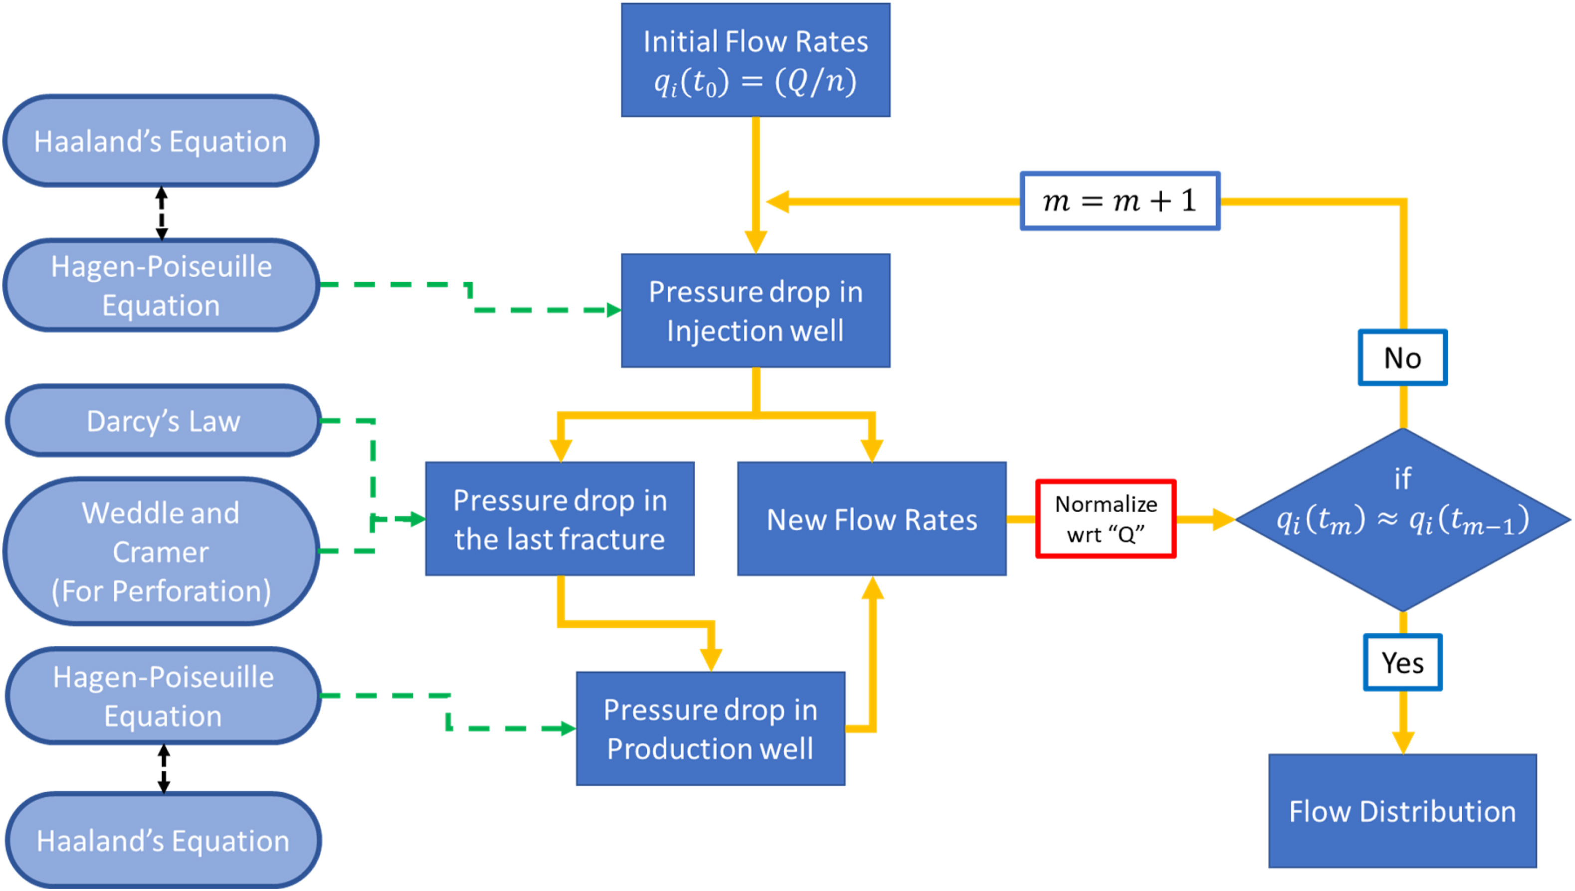
Nomenclature
Fracture 1 = Fracture nearest Heel of Well
Fracture 3 = Fracture nearest Toe of Well
With Exit Perforations
Without Exit Perforations
Flowchart representing workings of analytical model

Slide 8
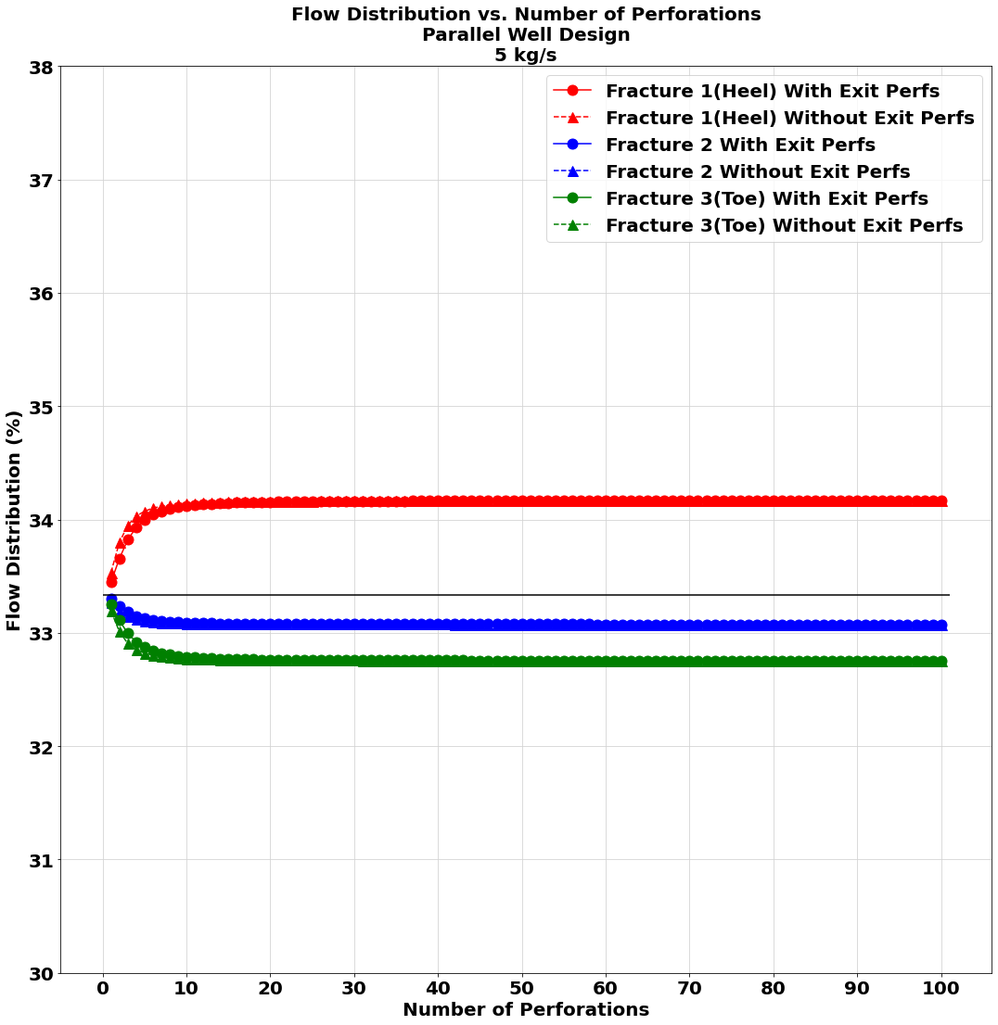
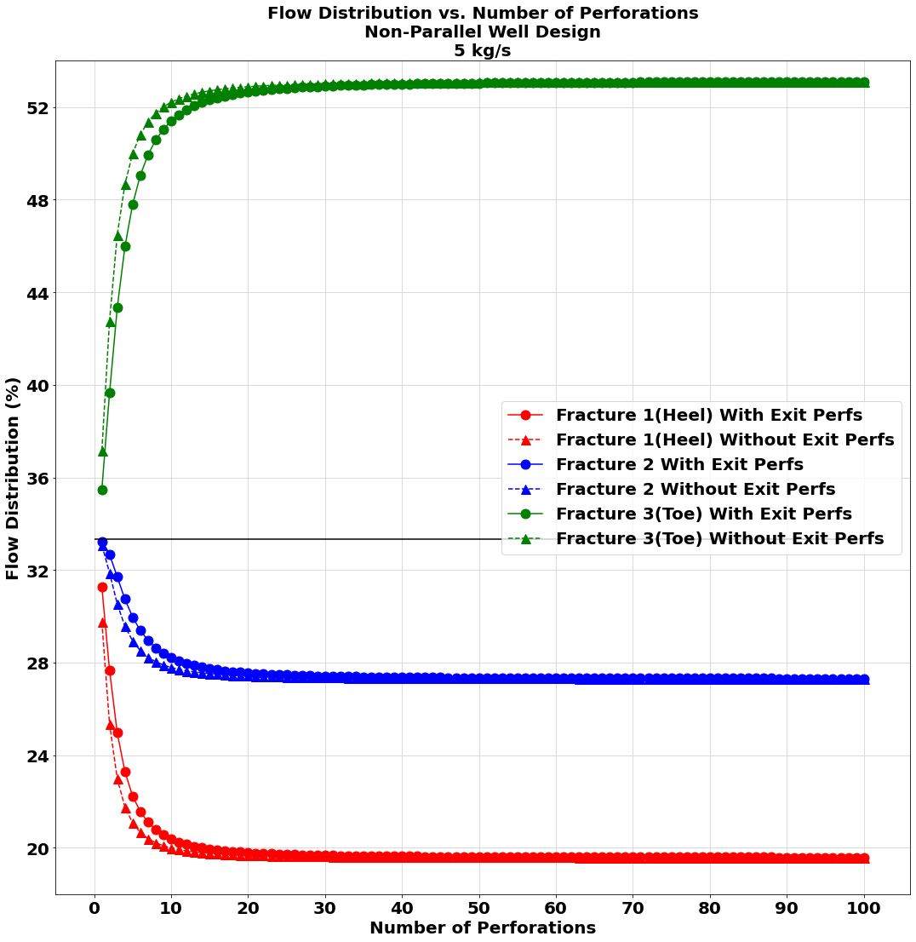
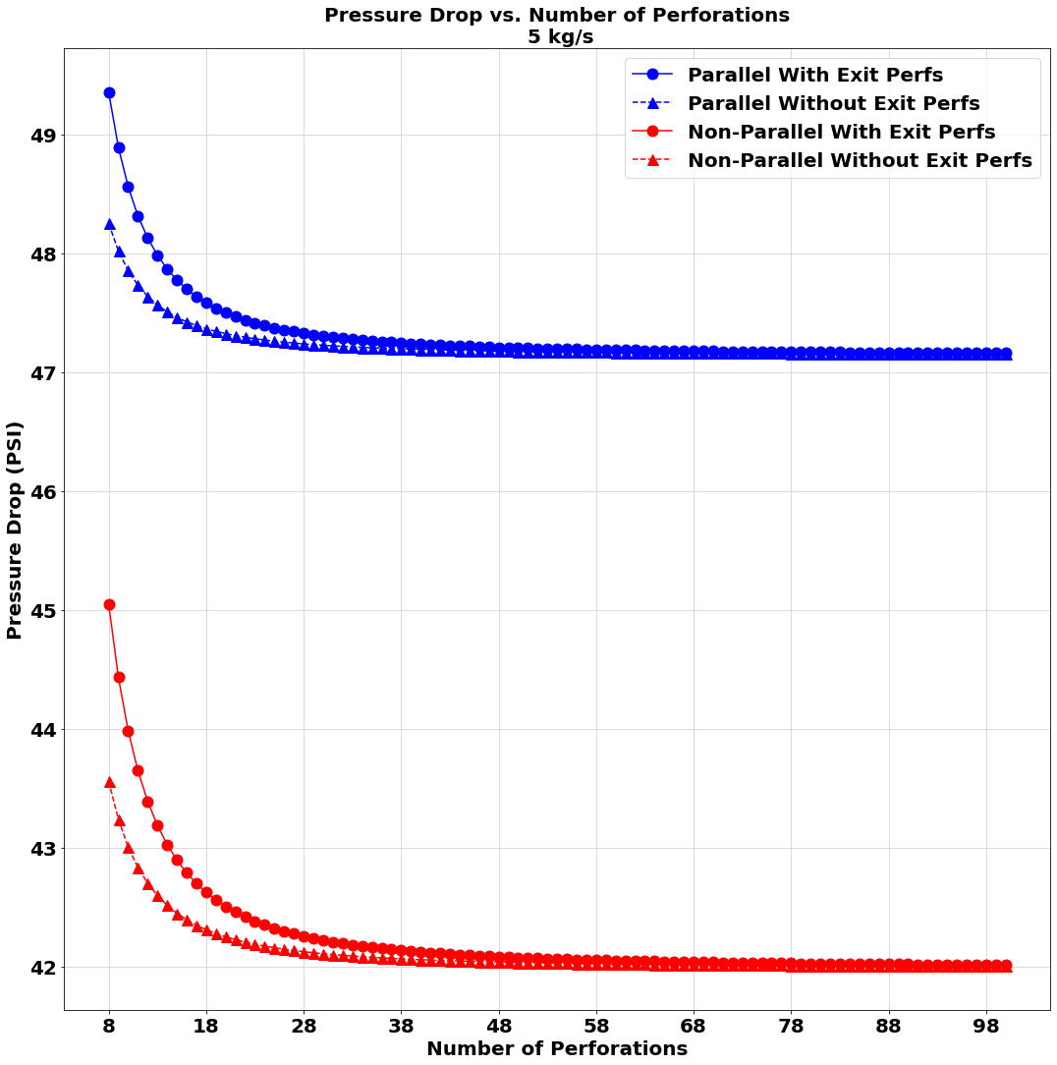
5 kg/s Flowrate Study

Slide 9
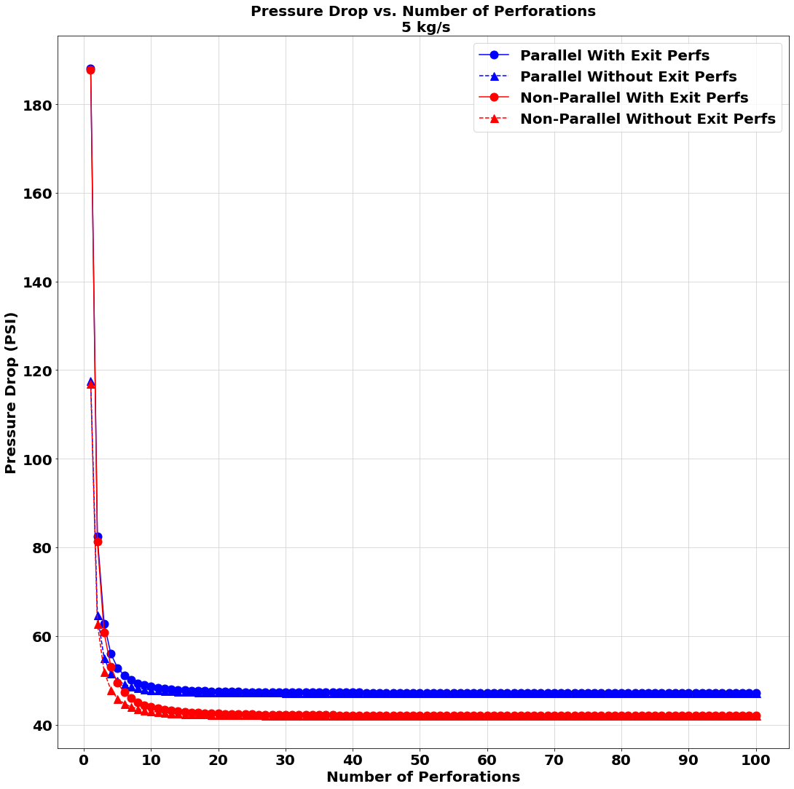
A zoomed-out portion of the third graph in slide 8

Slide 10
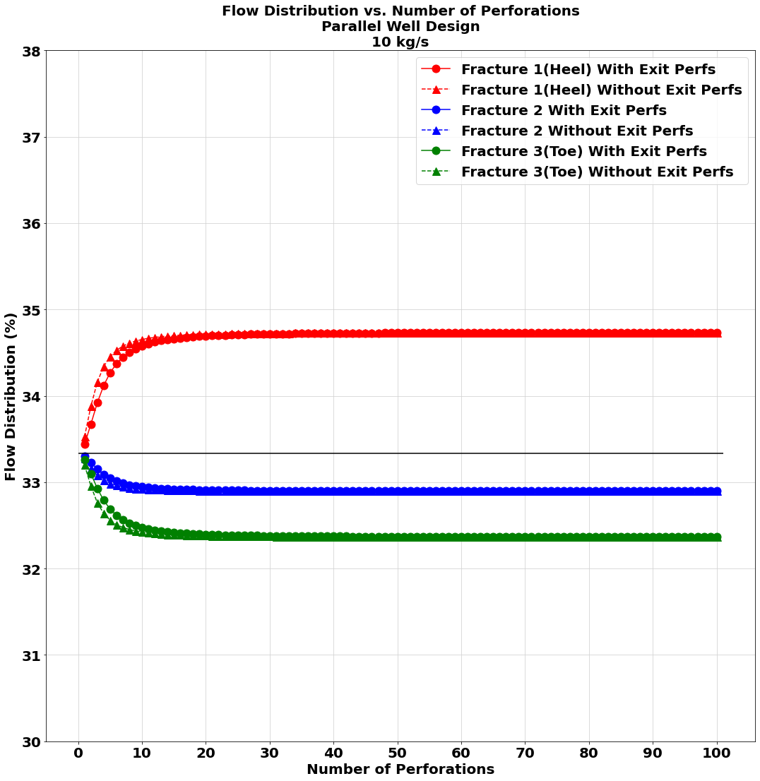
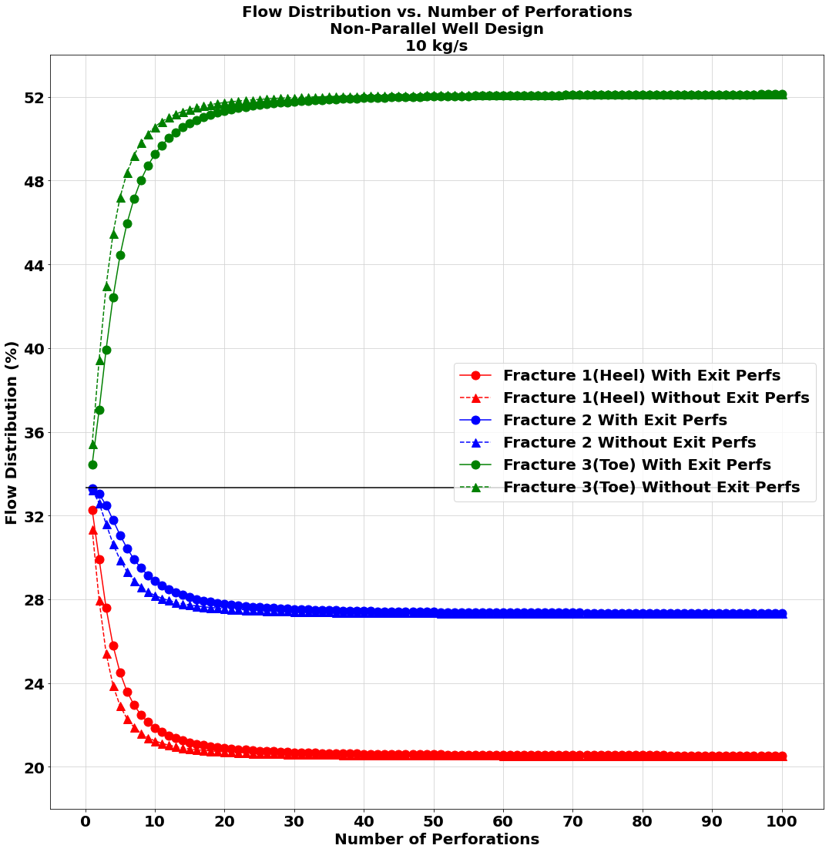
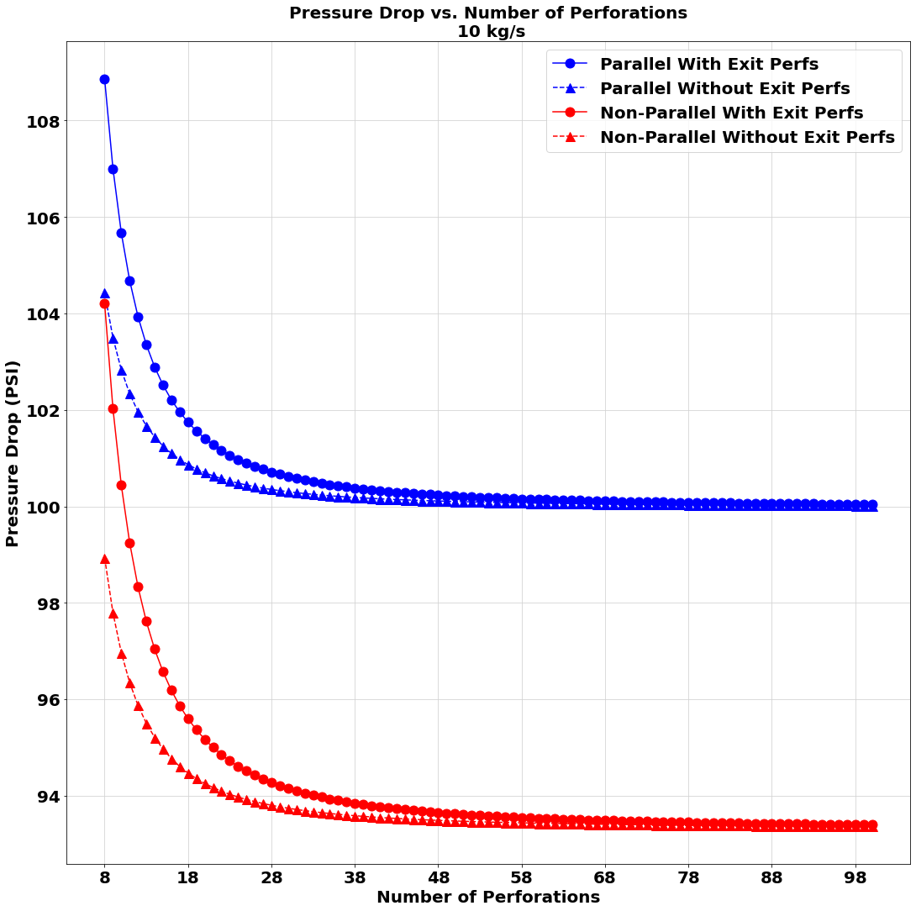
10 kg/s Flowrate Study

Slide 11
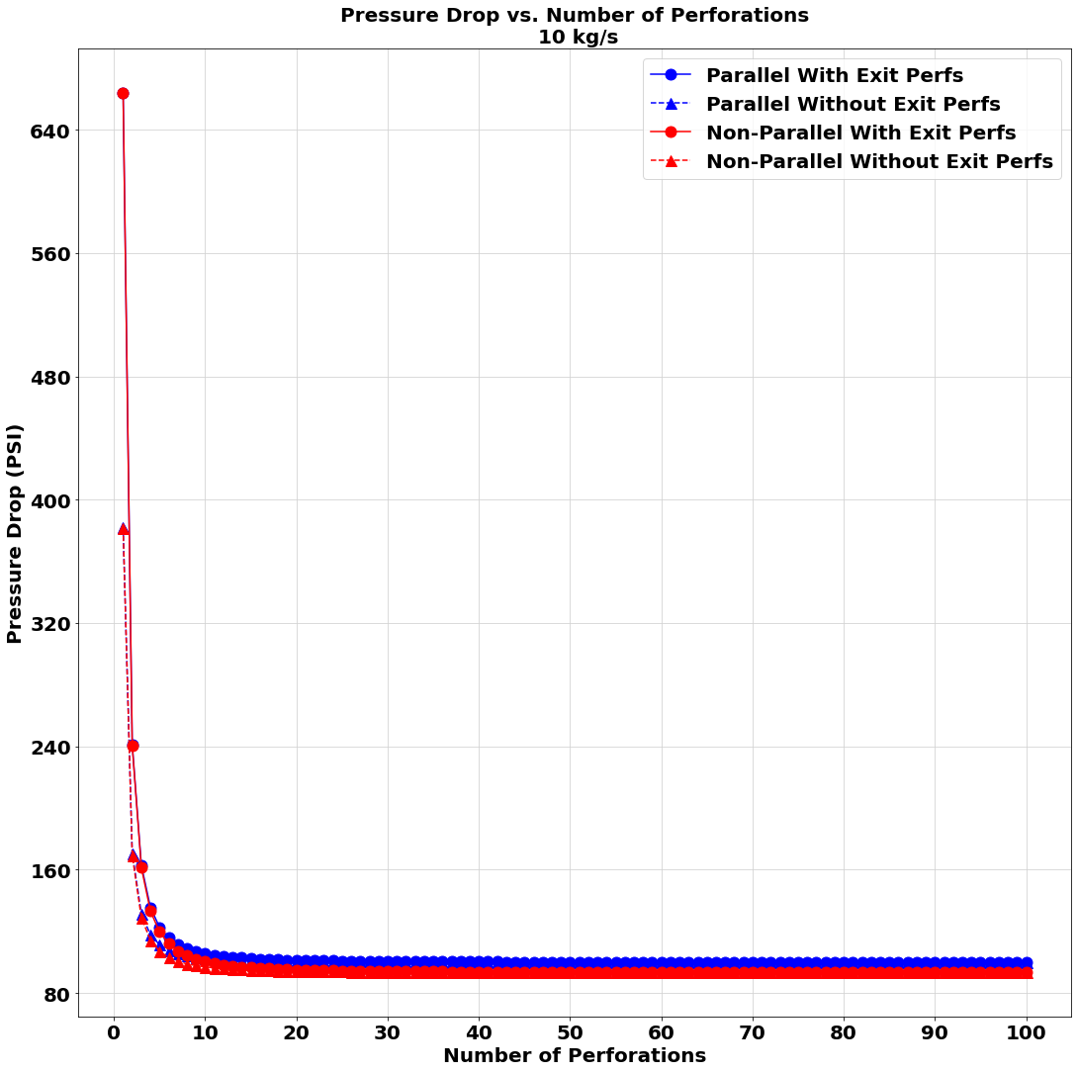
A zoomed-out portion of the third graph on slide 11

Slide 12
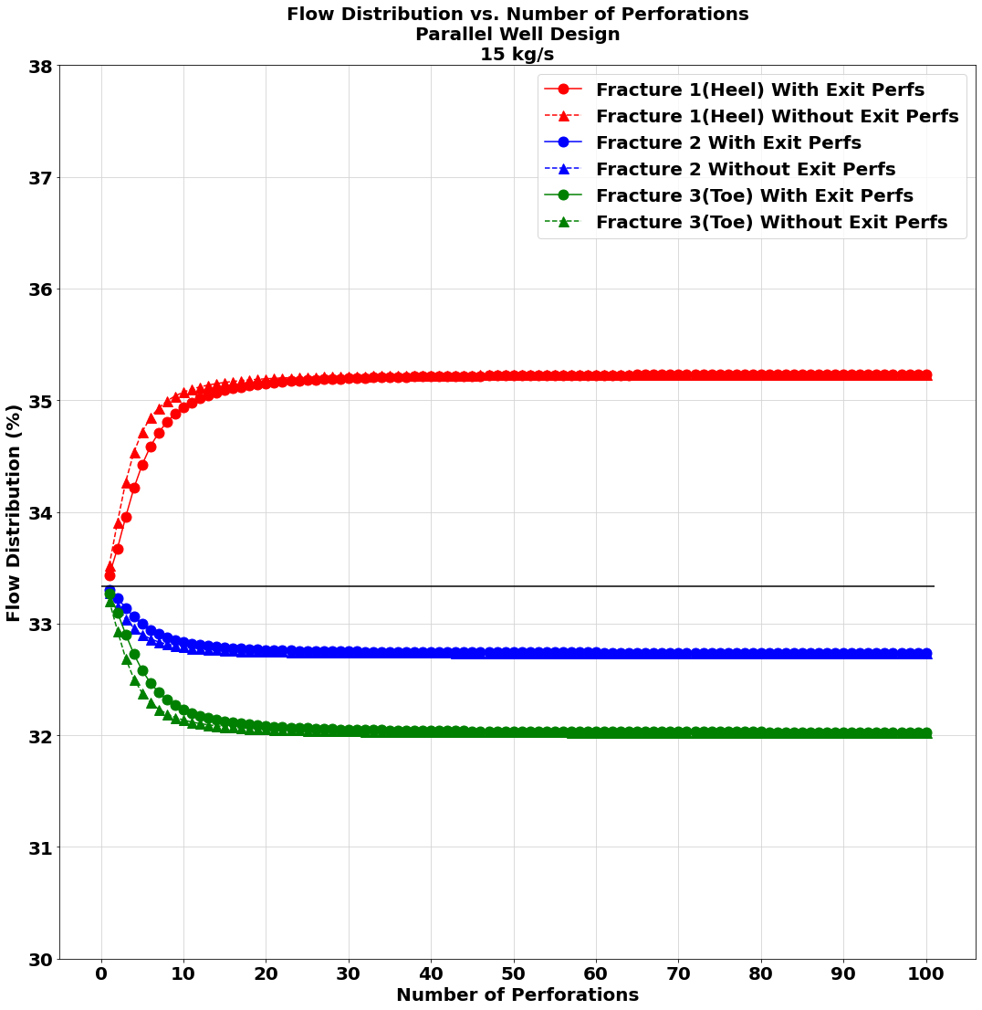
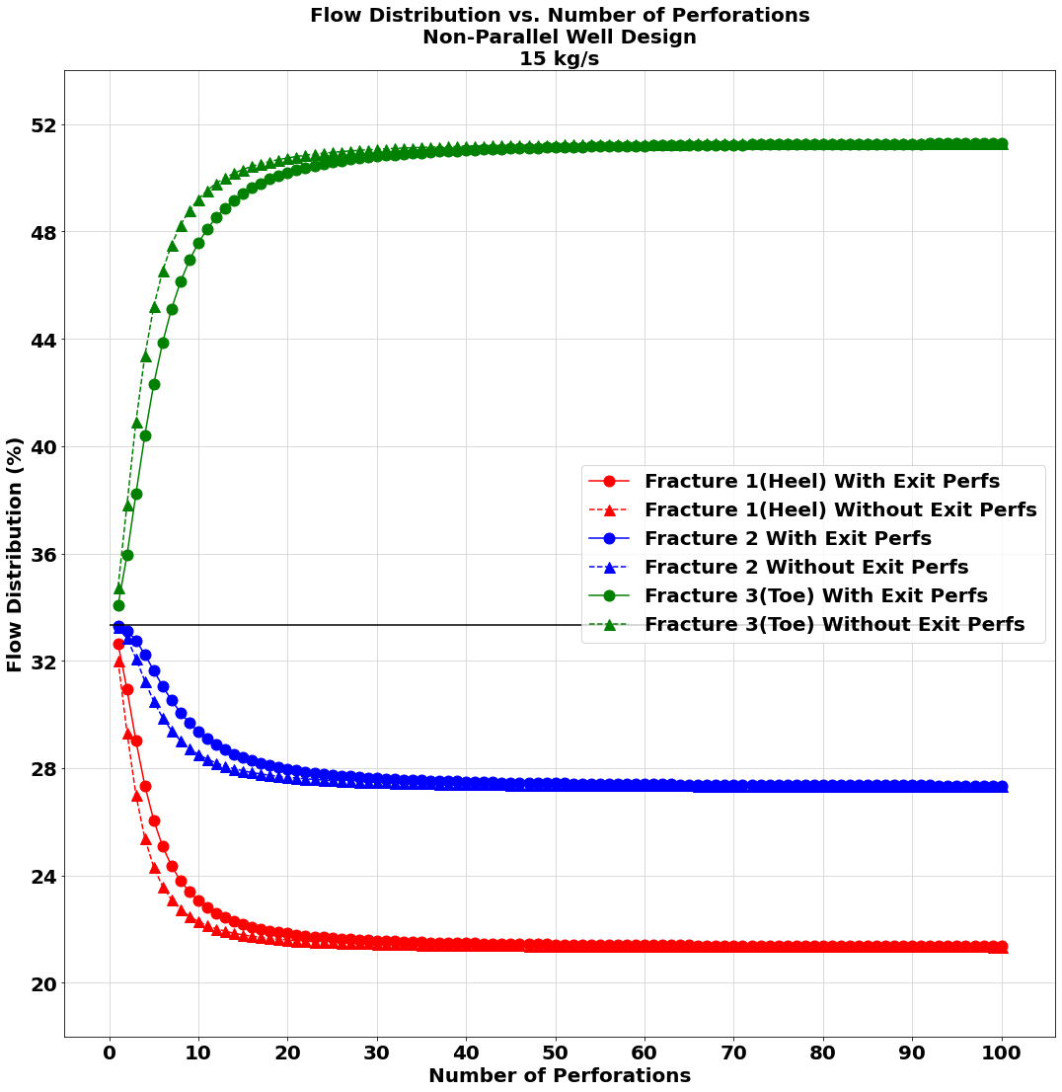
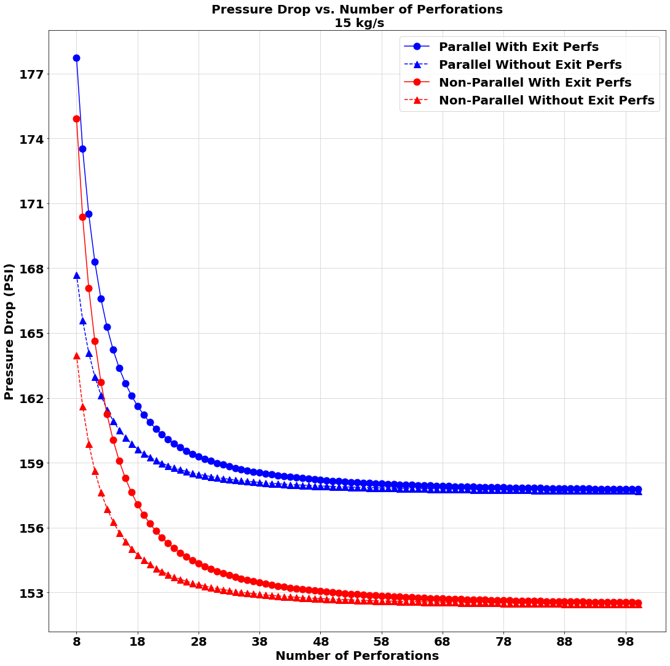
15 kg/s Flowrate Study

Slide 13
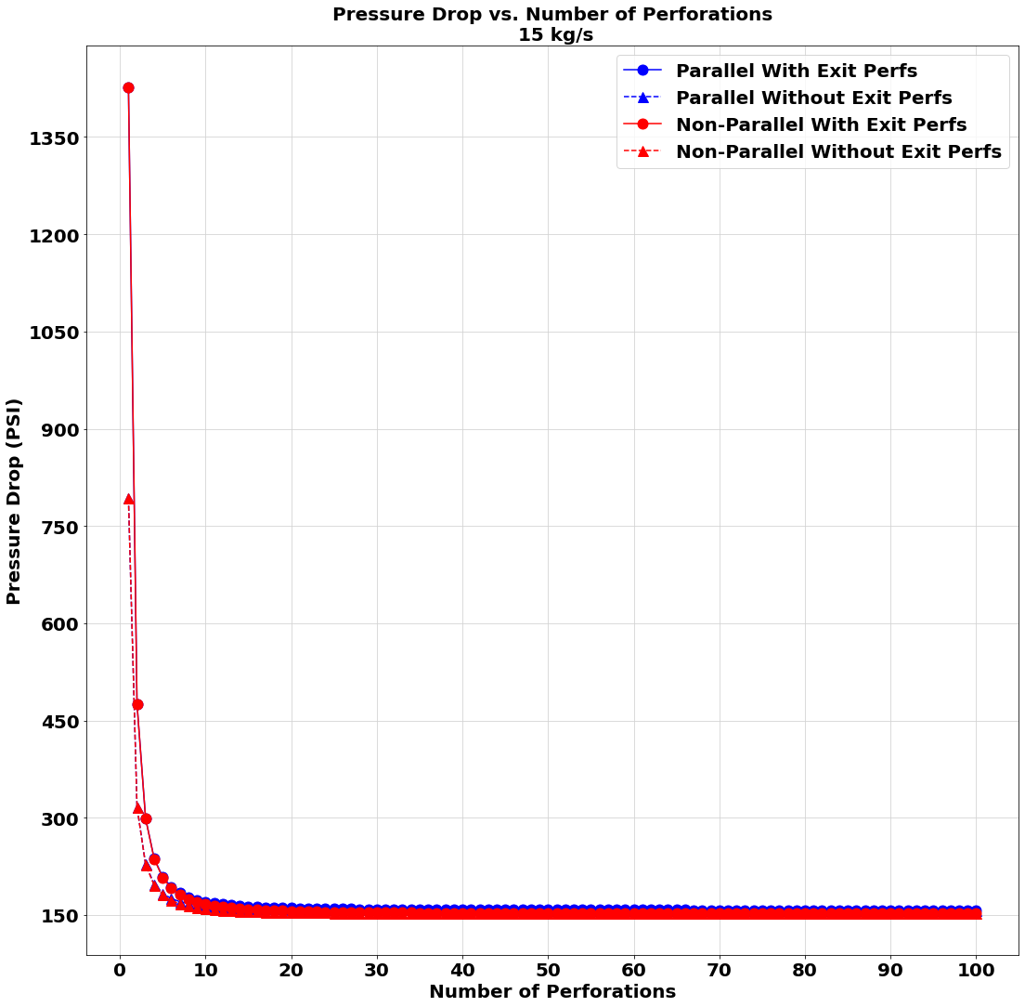
A zoomed-out portion of the third graph on slide 12

Slide 14
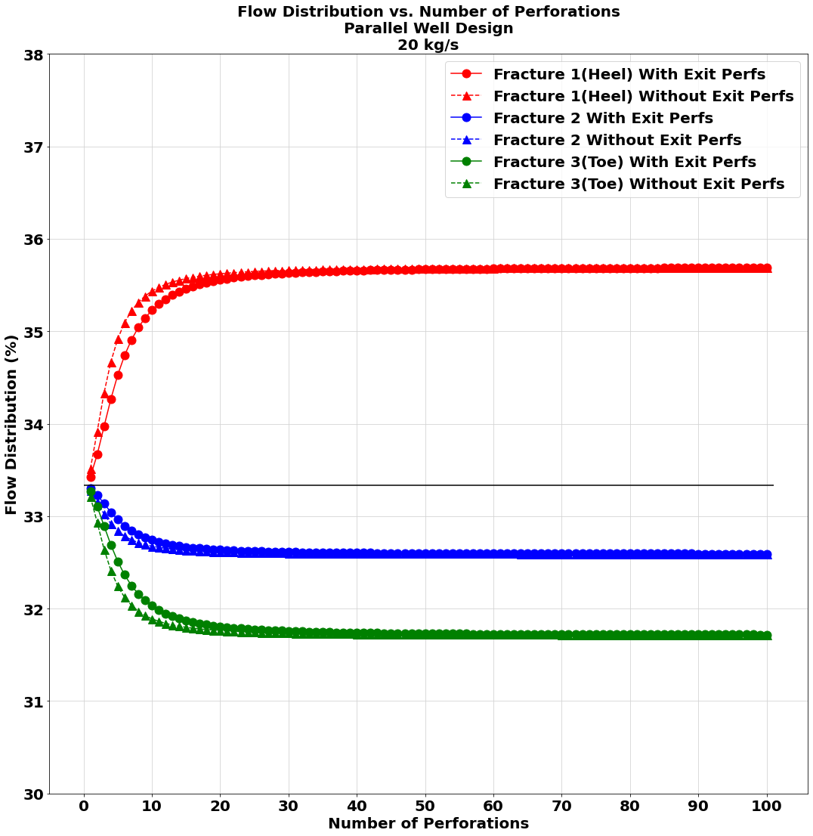
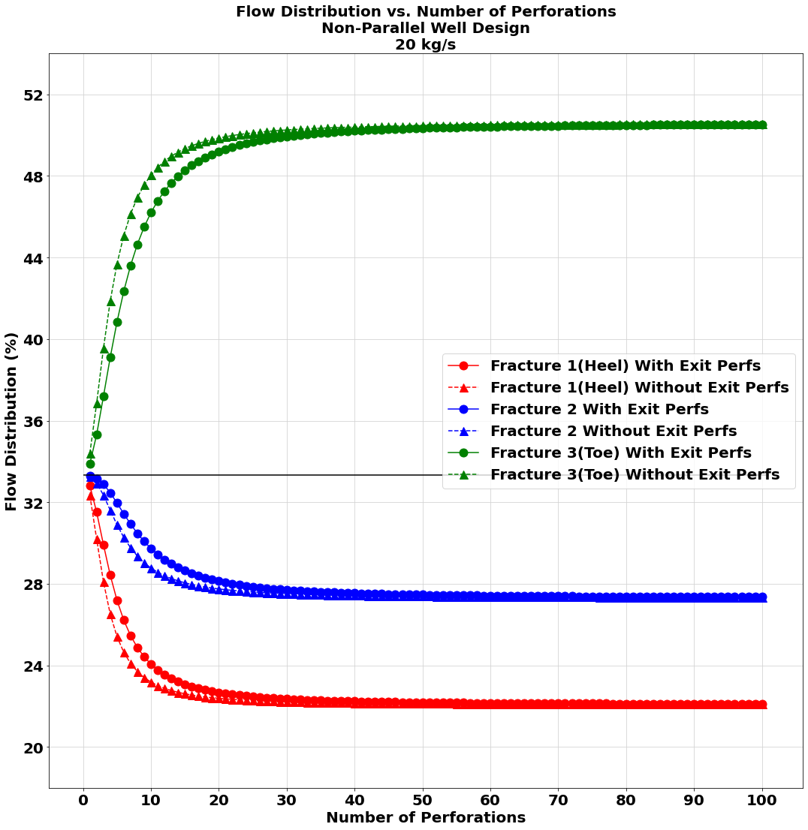
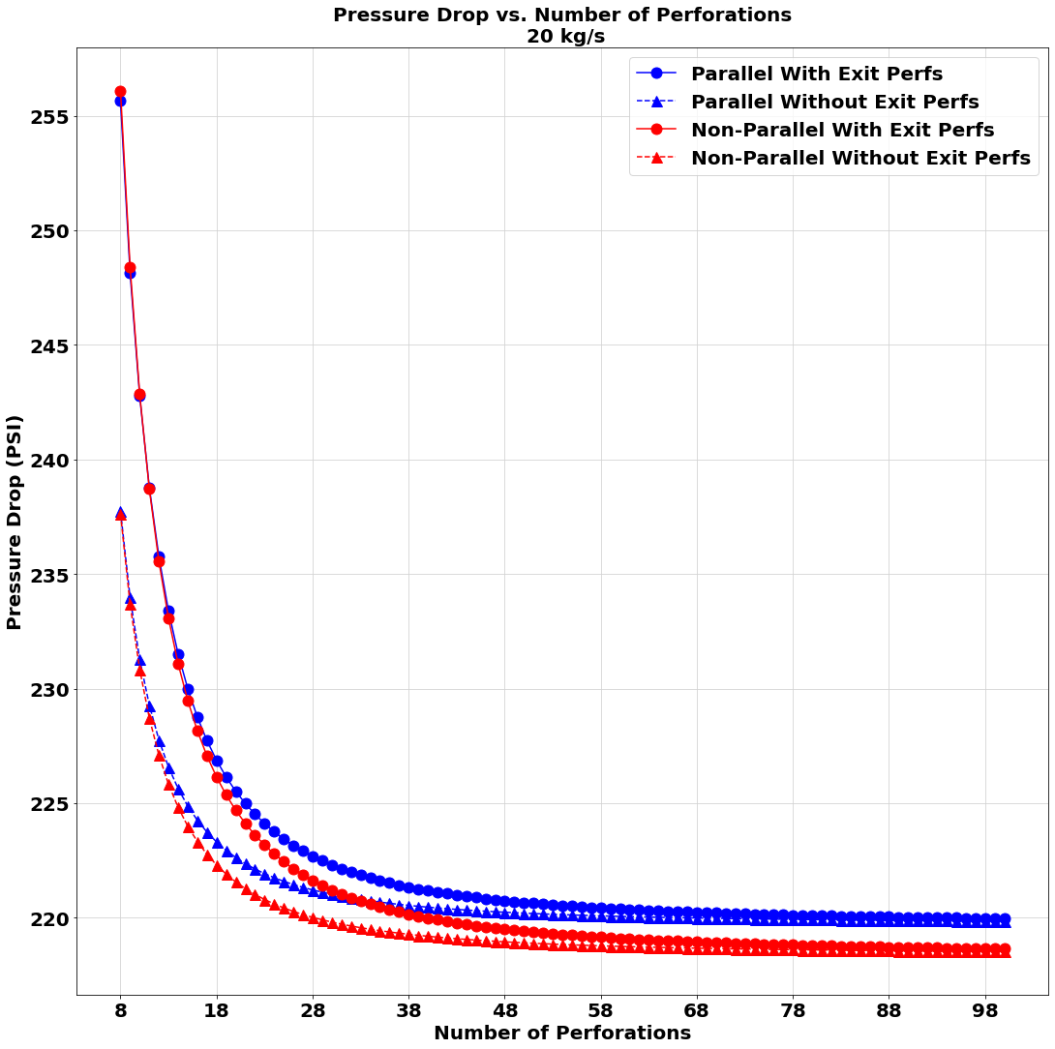
20 kg/s Flowrate Study

Slide 15
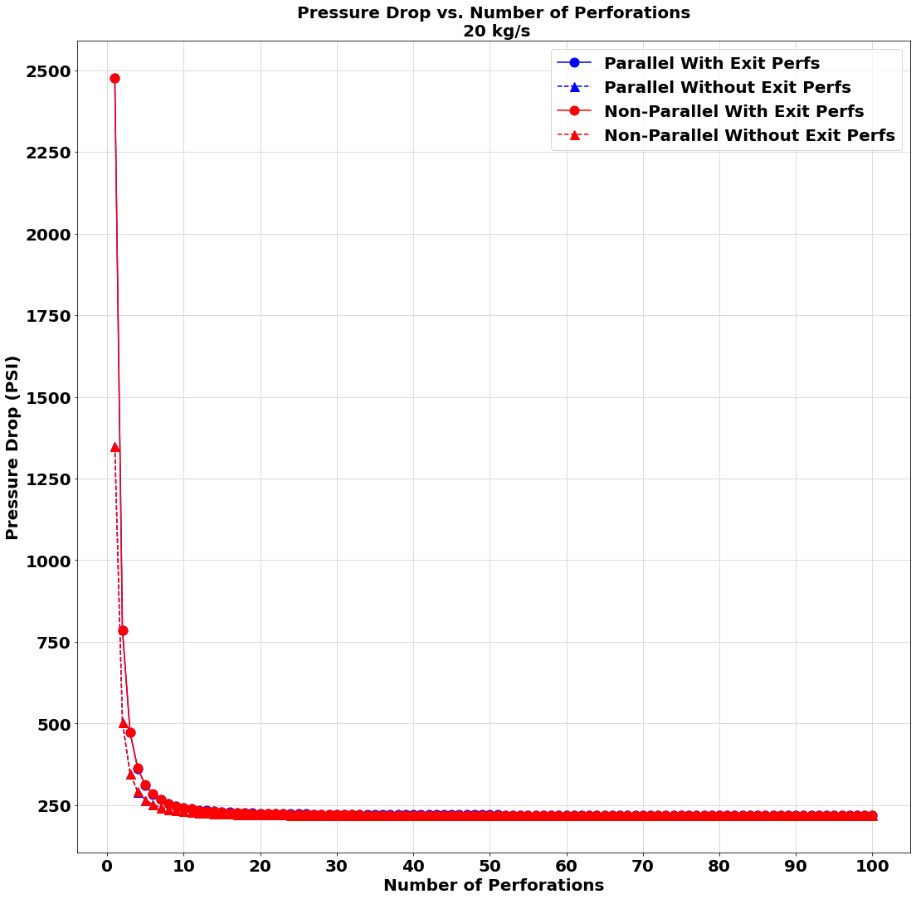
A zoomed-out portion of the third graph on slide 14

Slide 16
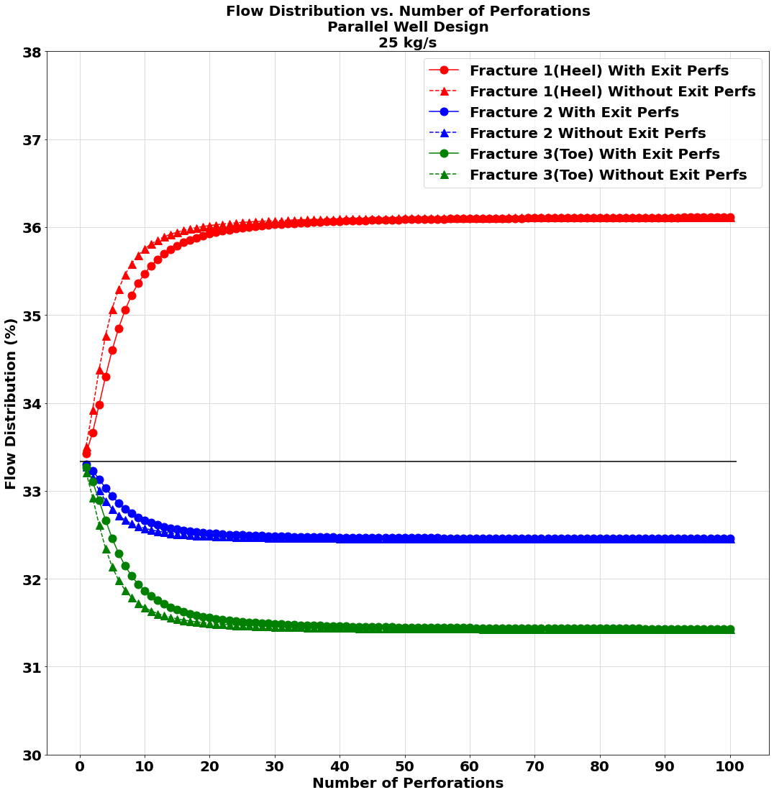
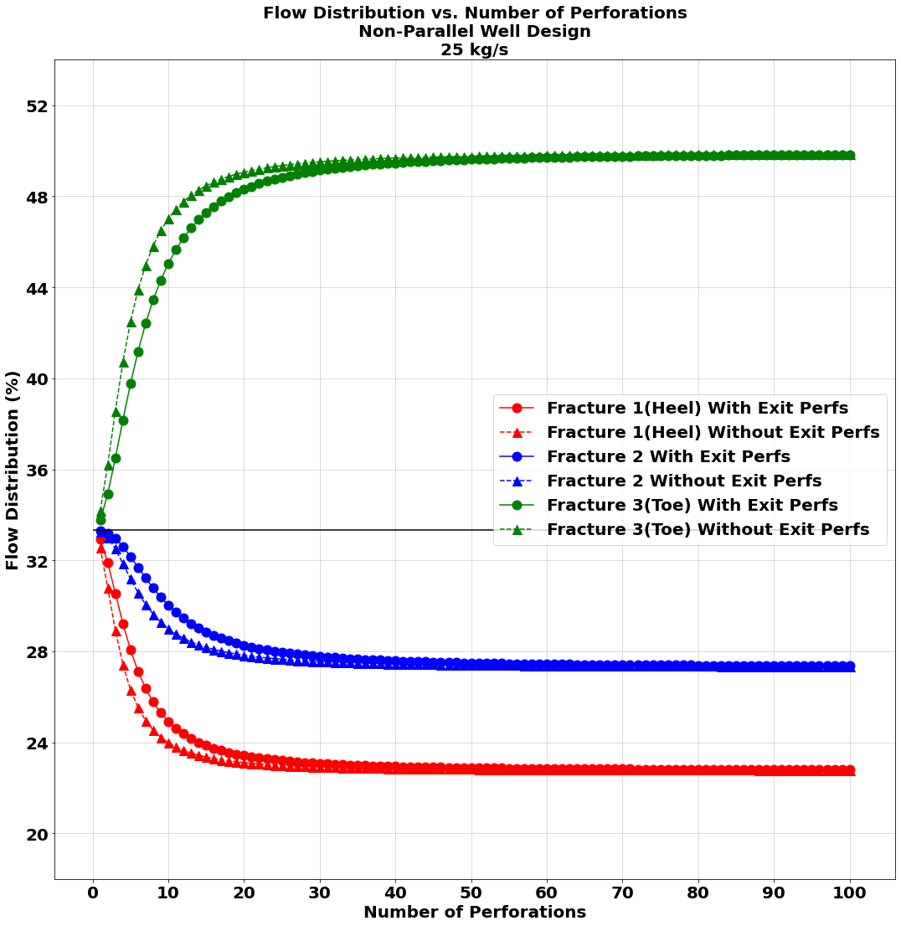
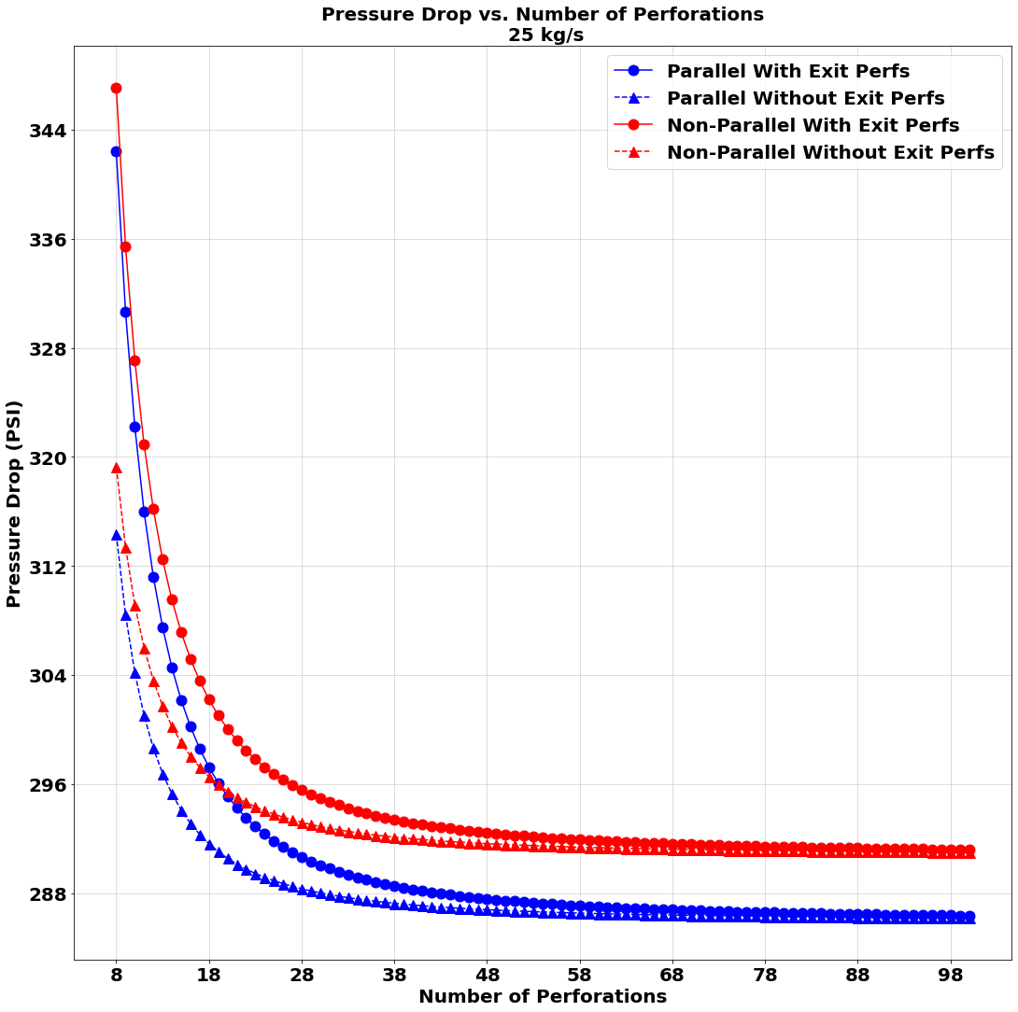
25 kg/s Flowrate Study

Slide 17
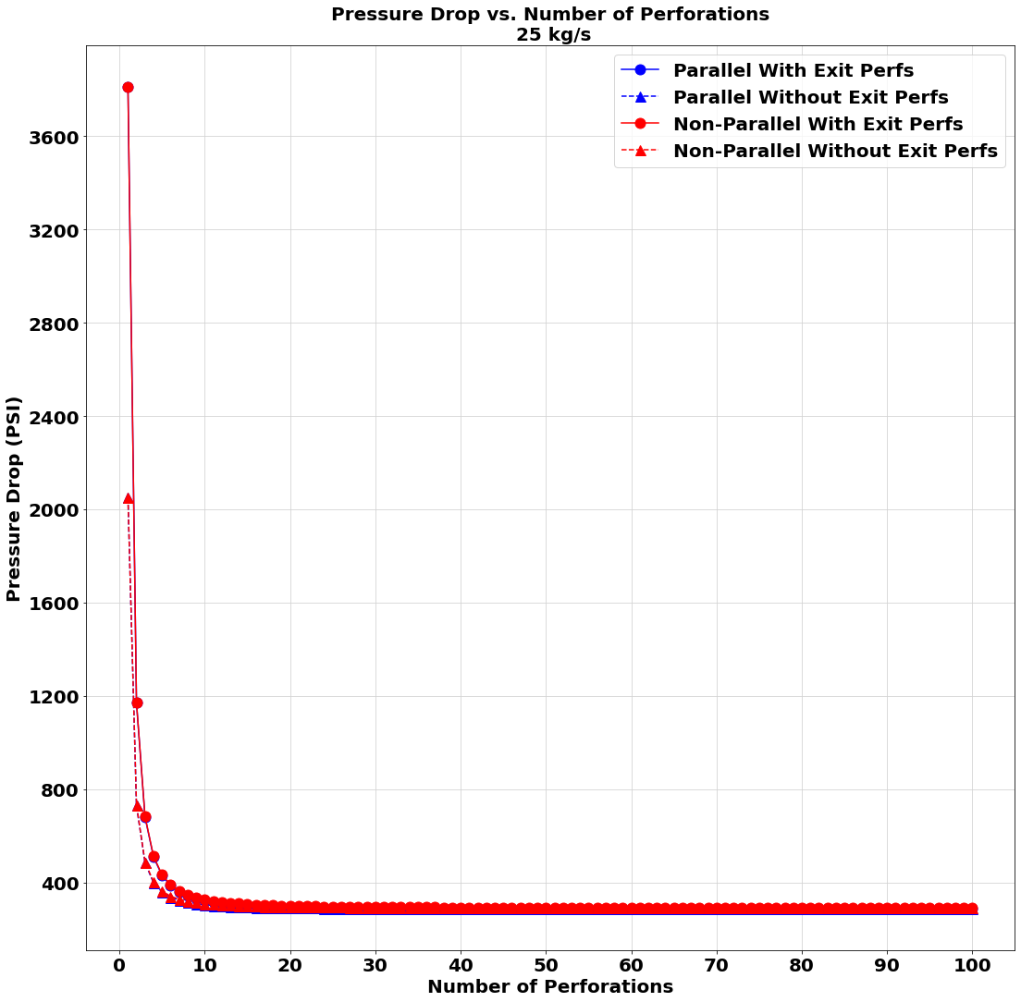
A zoomed-out portion of the third graph on slide 16

Slide 18
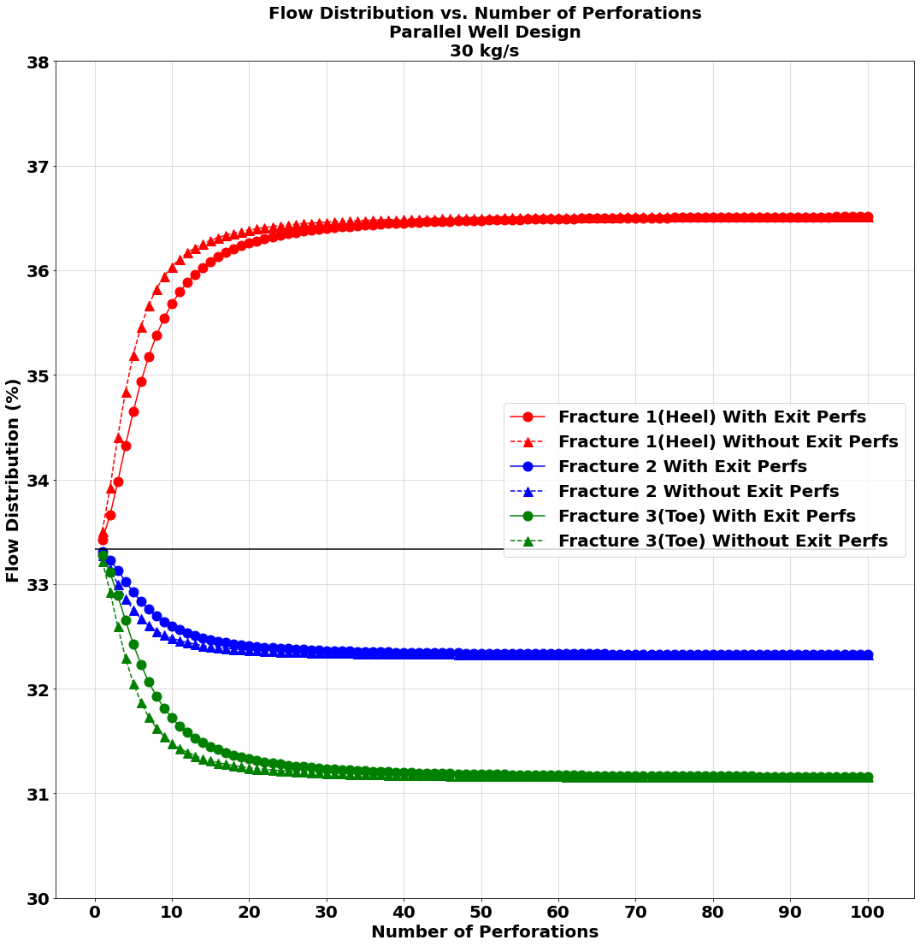
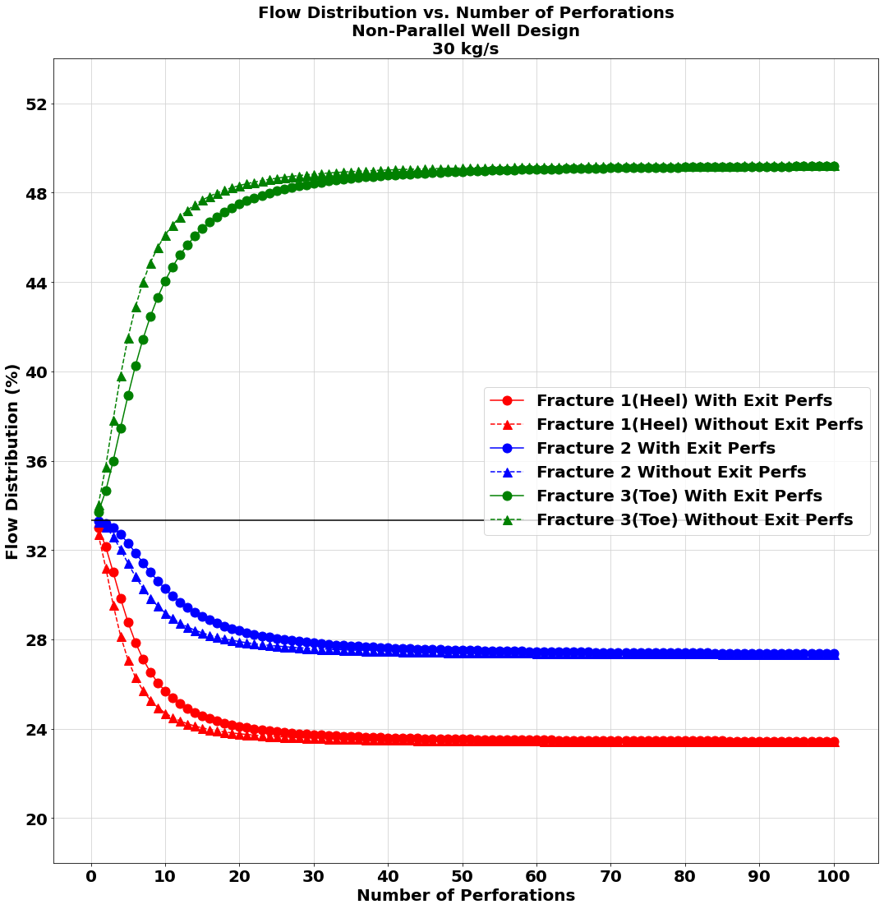
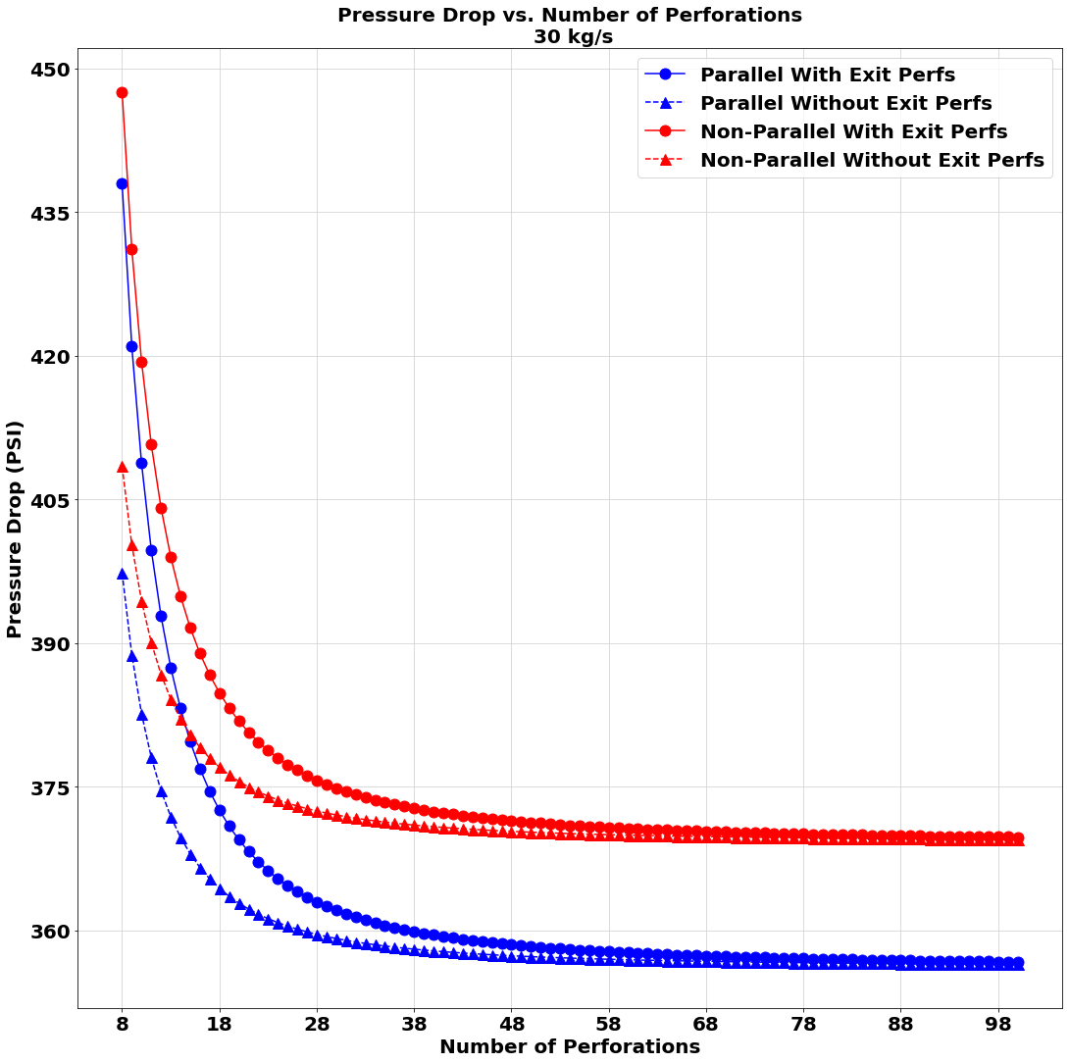
30 kg/s Flowrate Study

Slide 19
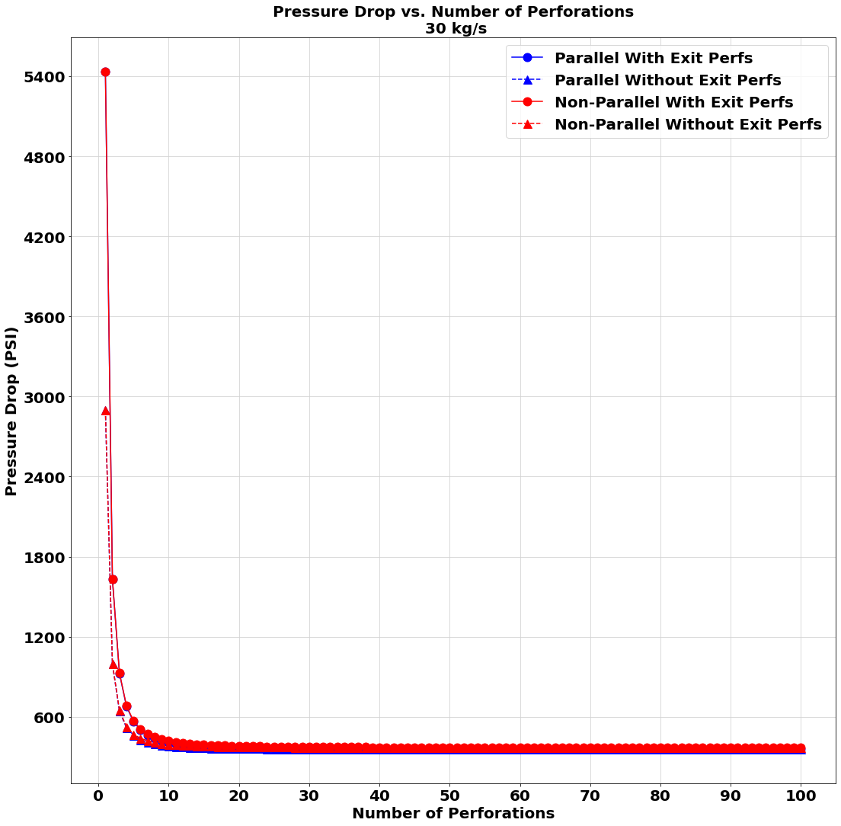
A zoomed-out portion of the third graph on slide 19

Slide 20
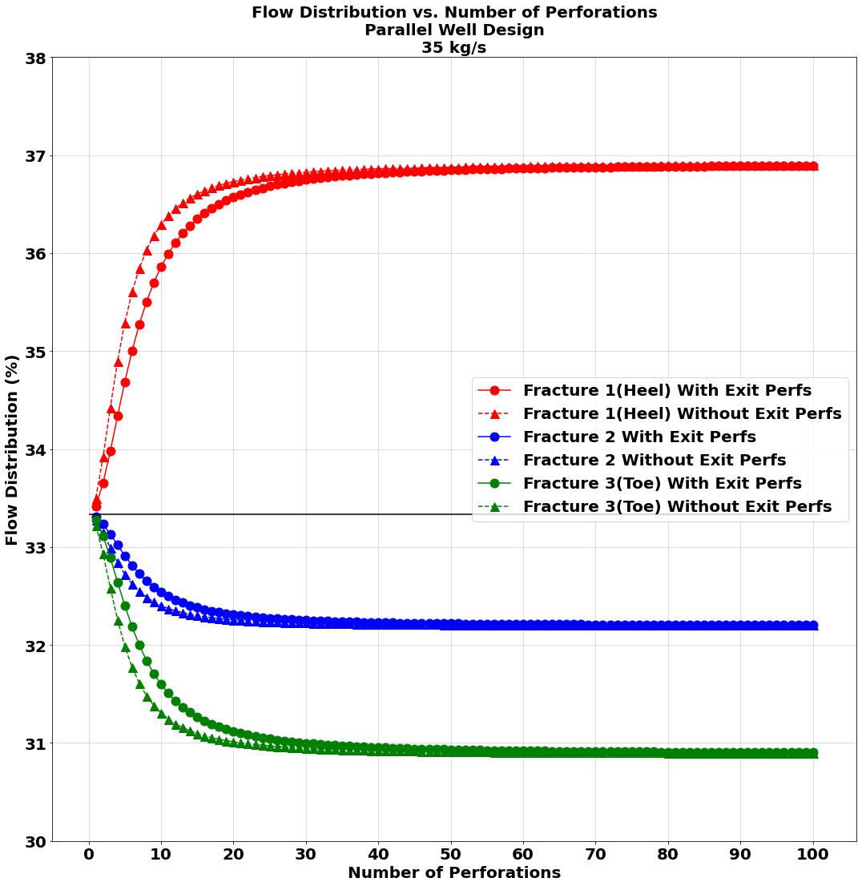
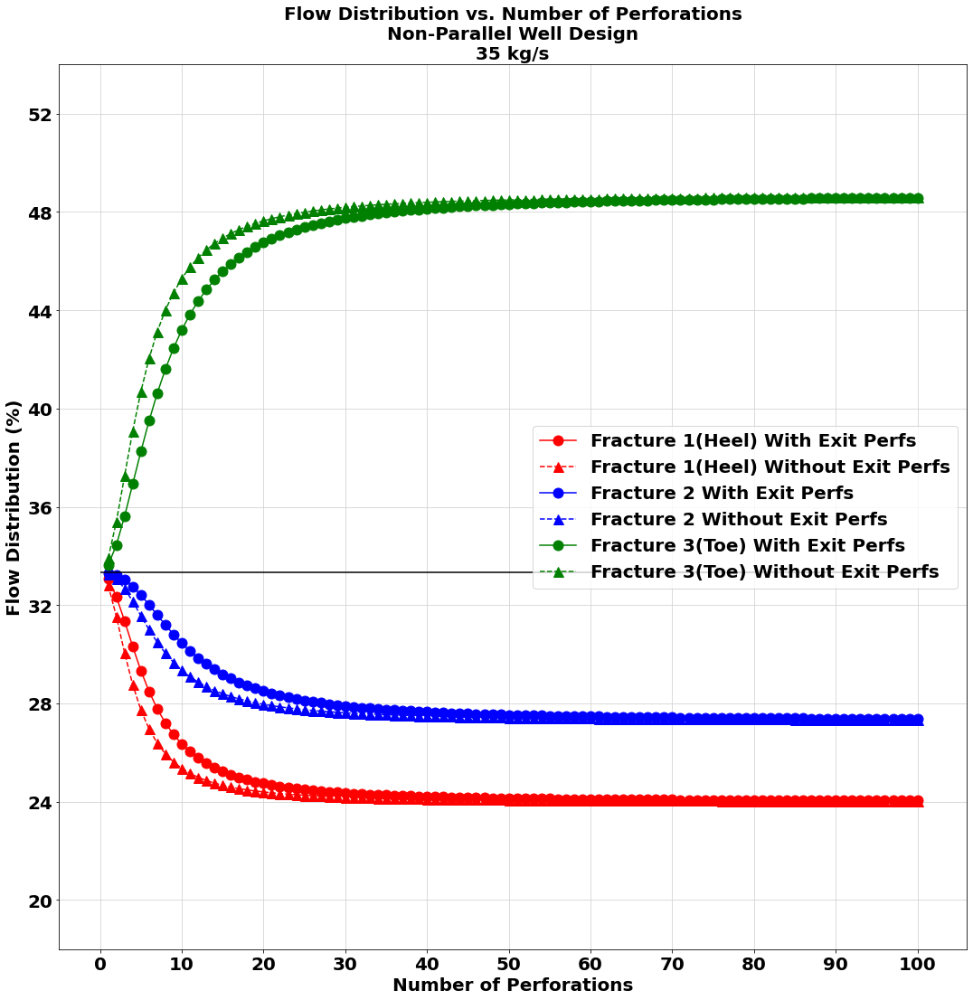
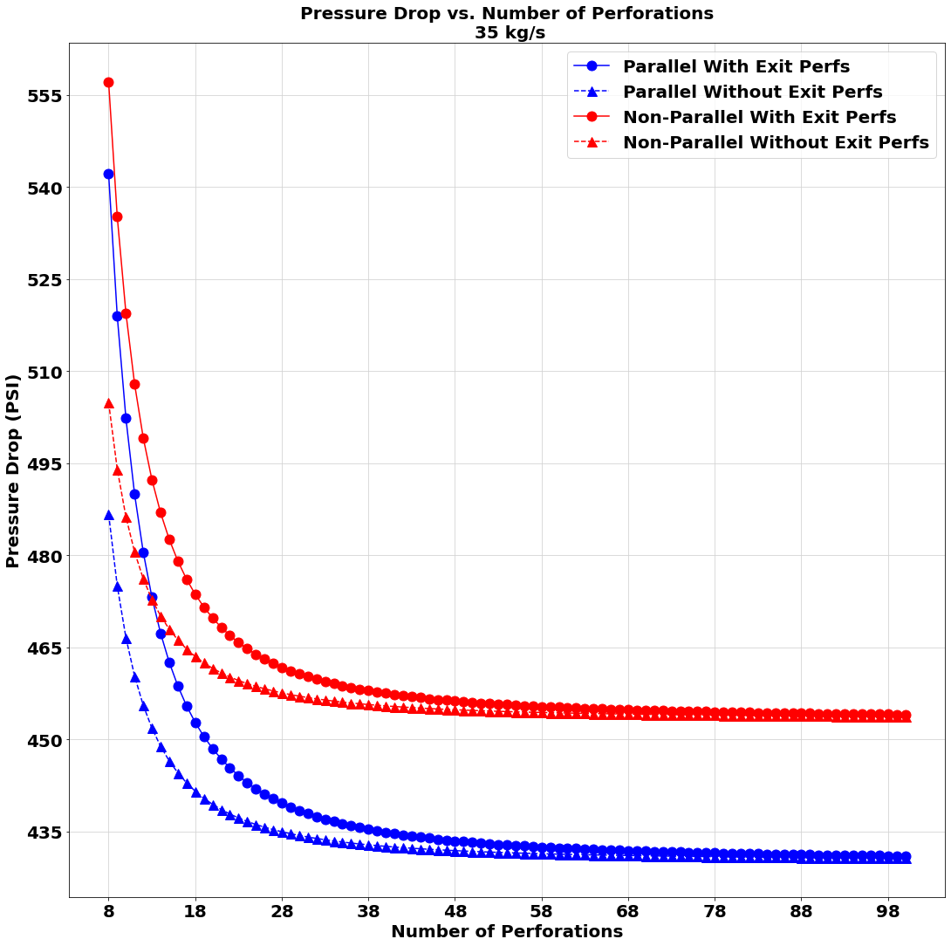
35 kg/s Flowrate Study

Slide 21
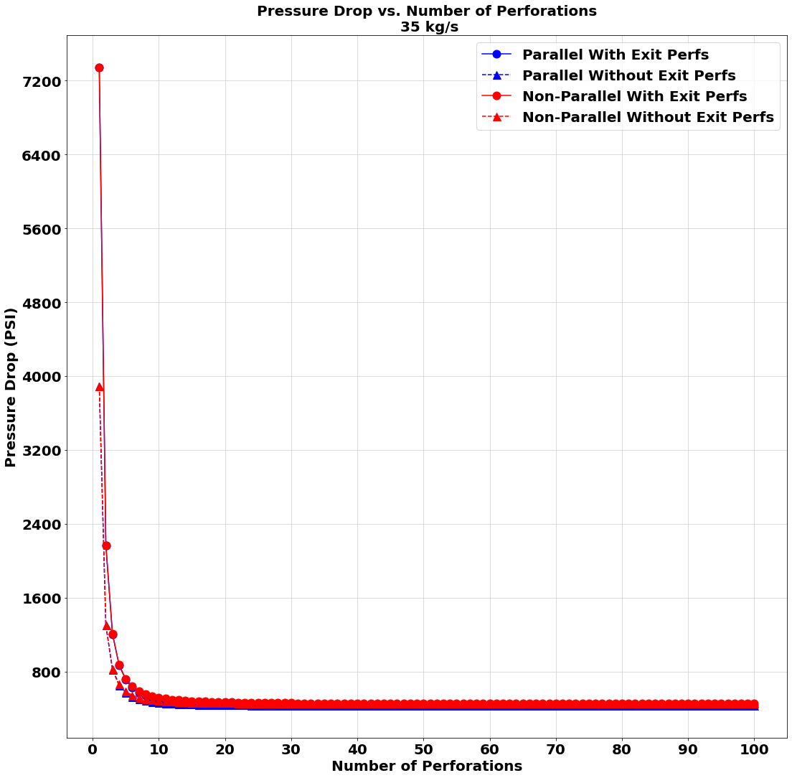
A zoomed-out portion of the third graph on slide 20

Slide 22
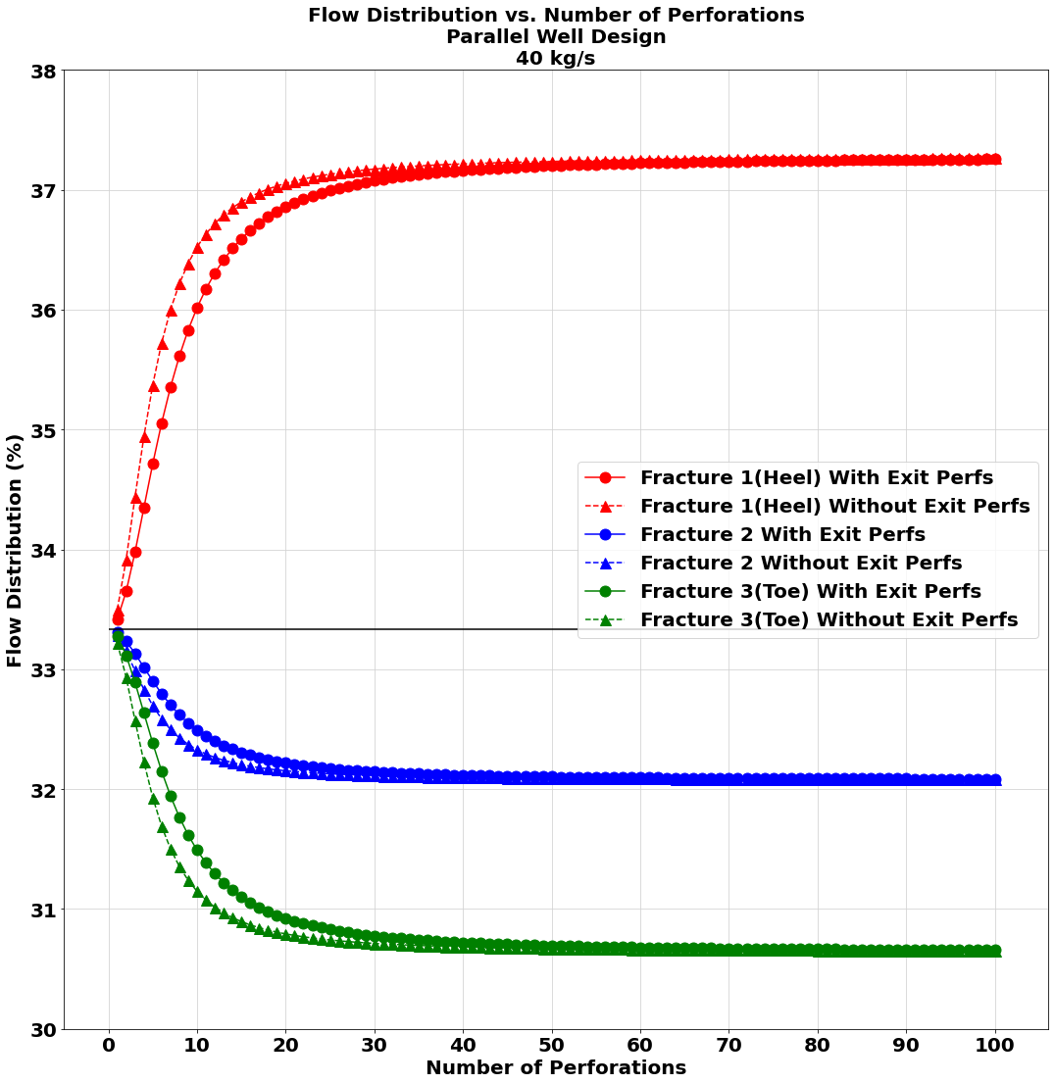
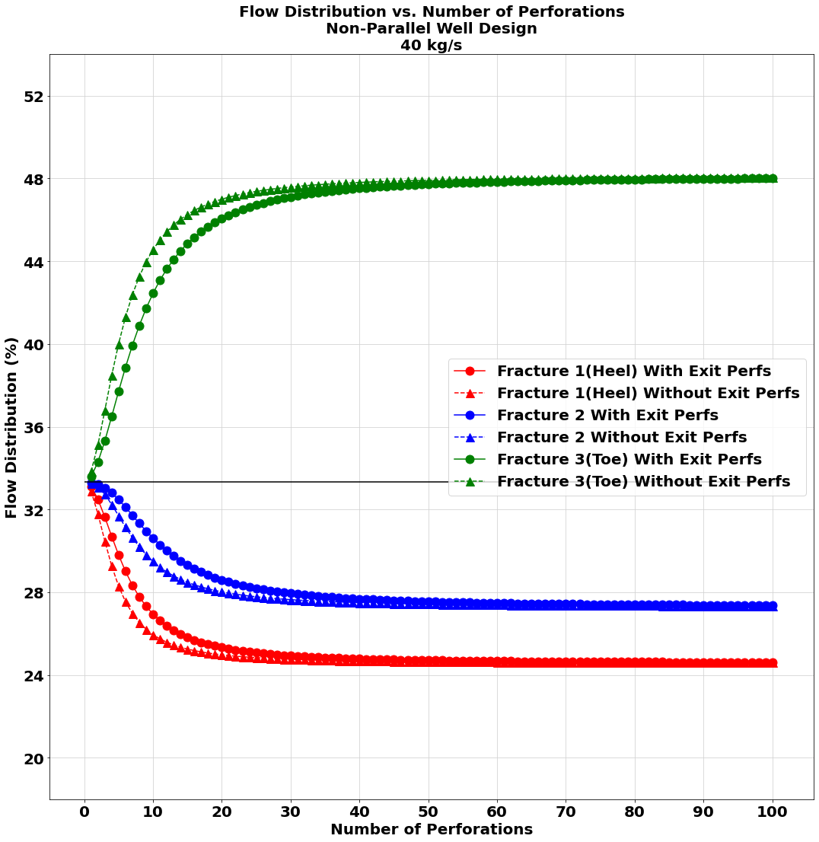
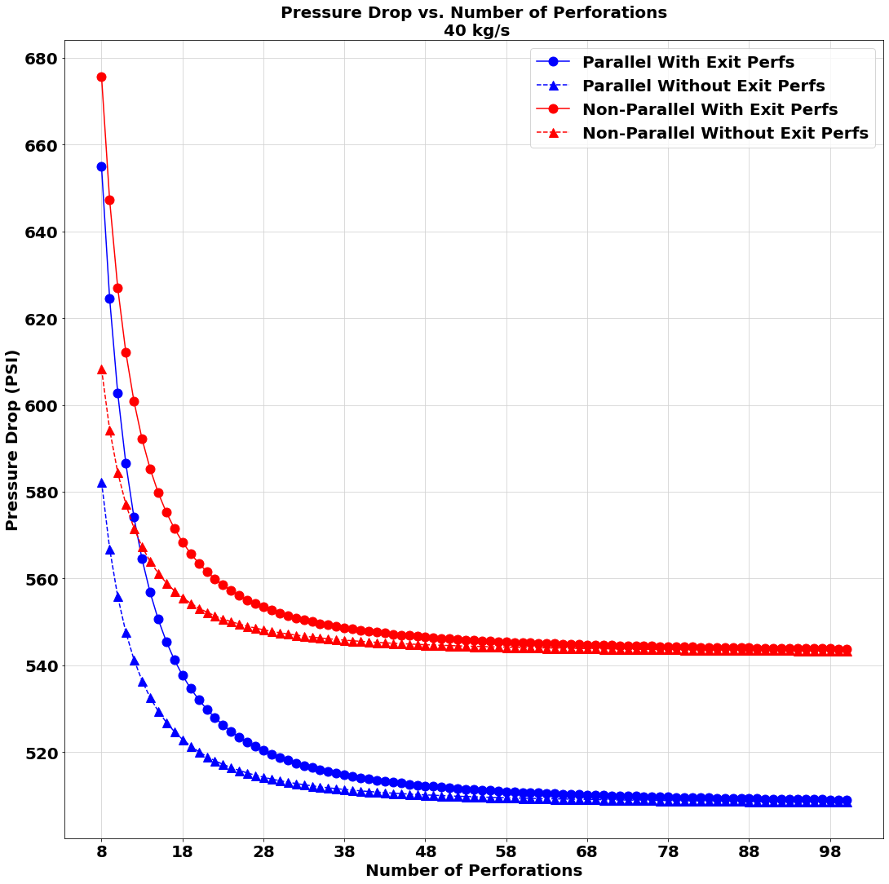
40 kg/s Flowrate Study

Slide 23
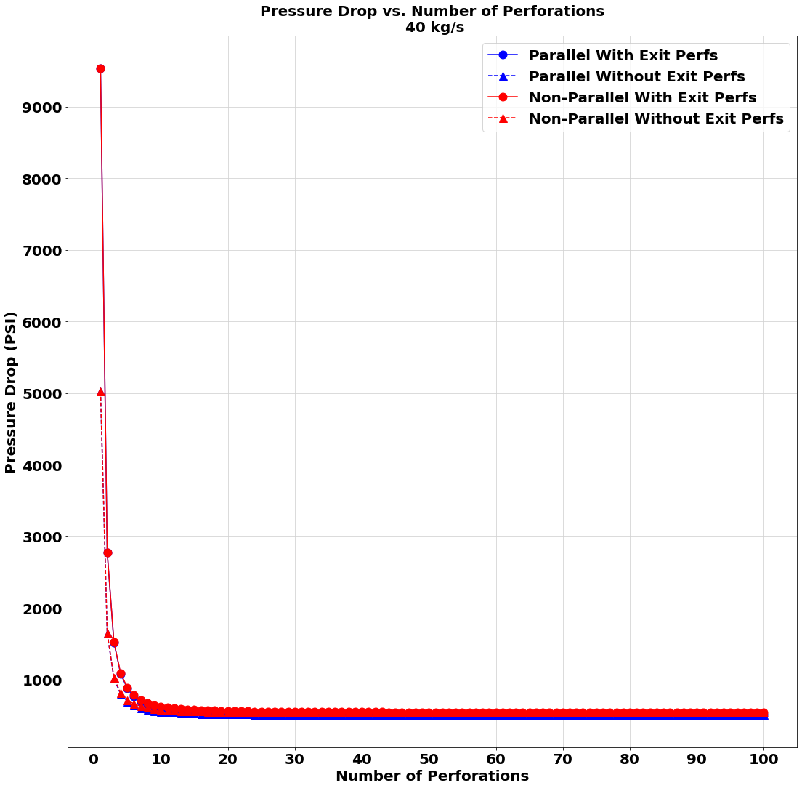
A zoomed-out portion of the third graph on slide 23

Slide 24
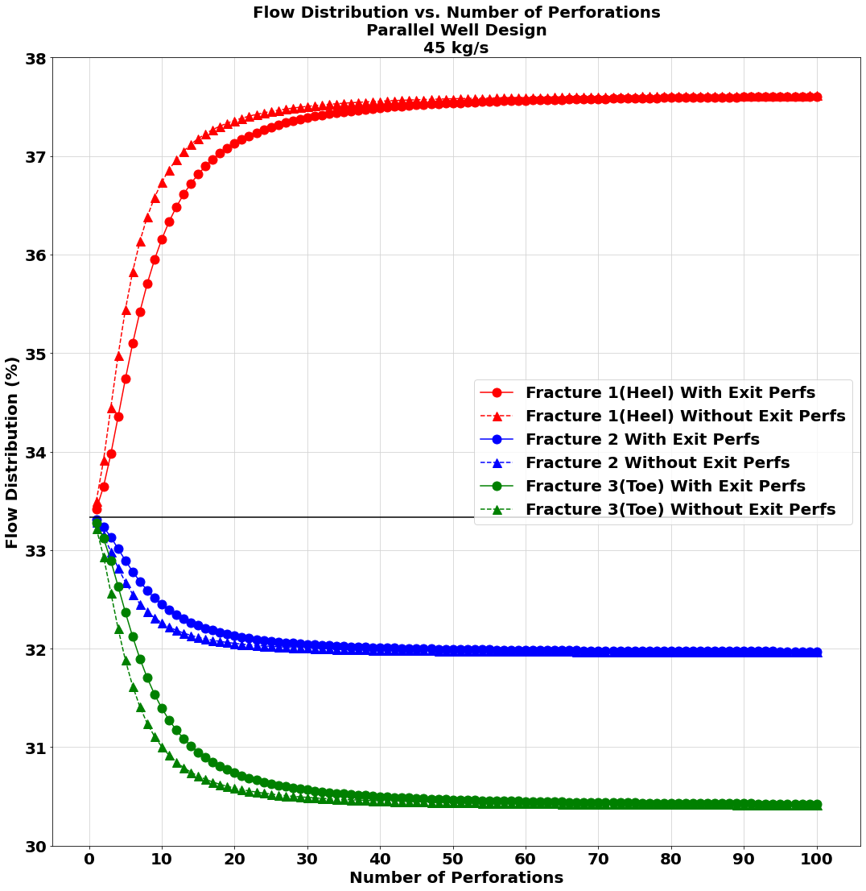
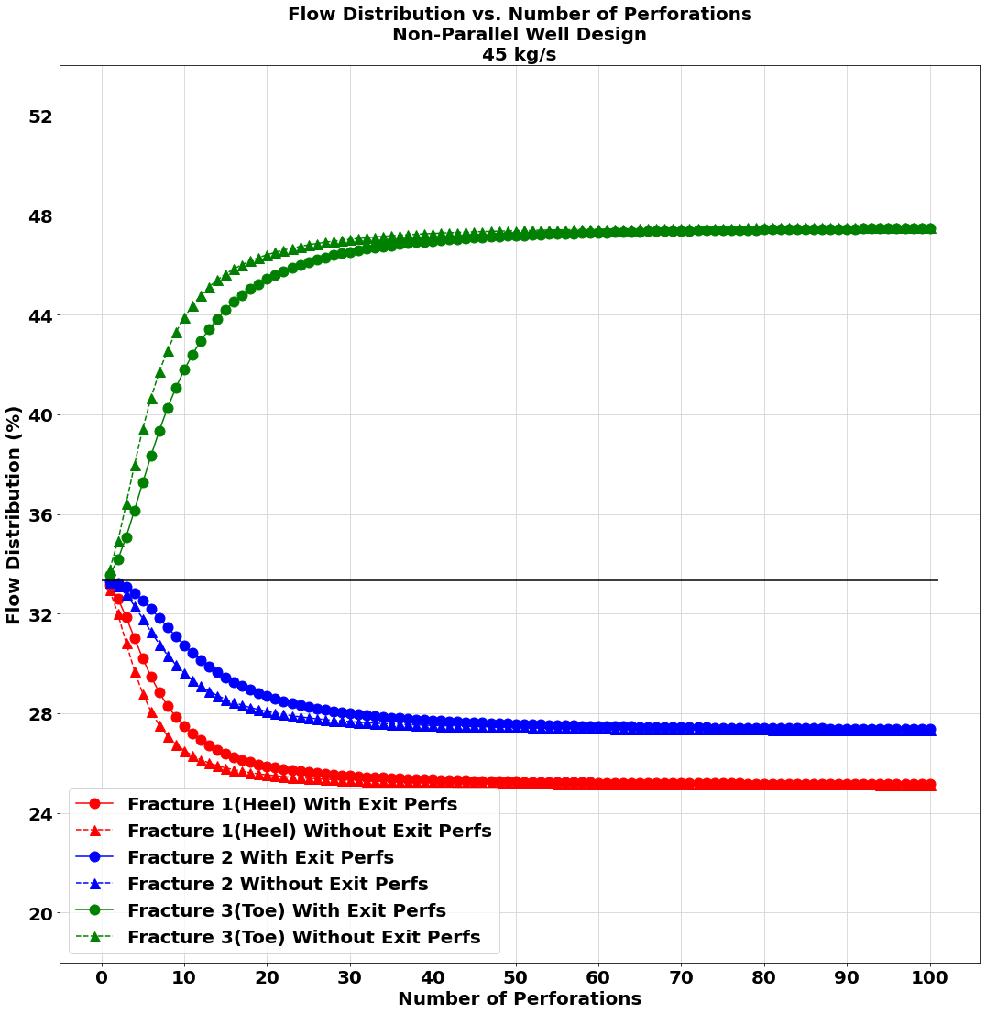
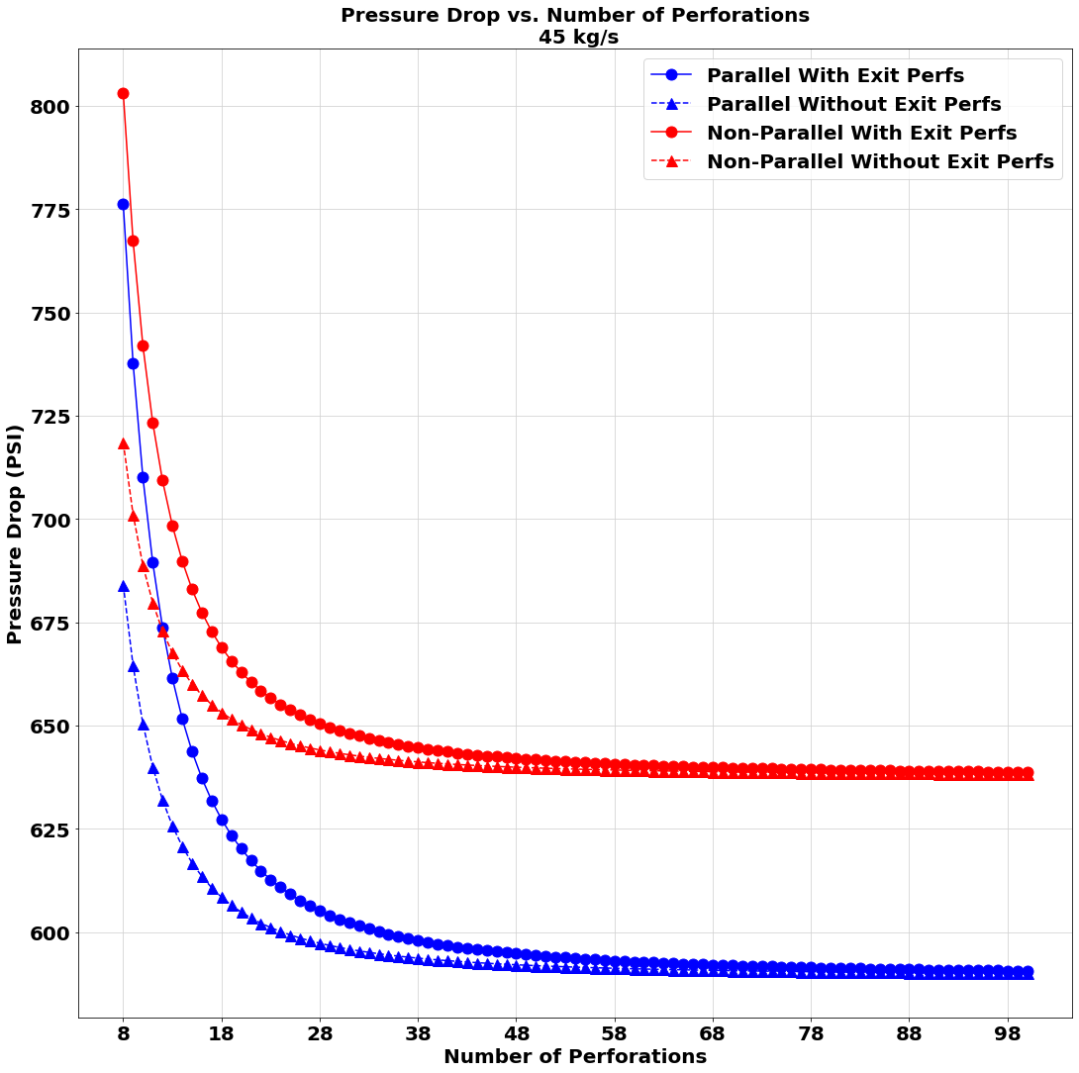
45 kg/s Flowrate Study

Slide 25
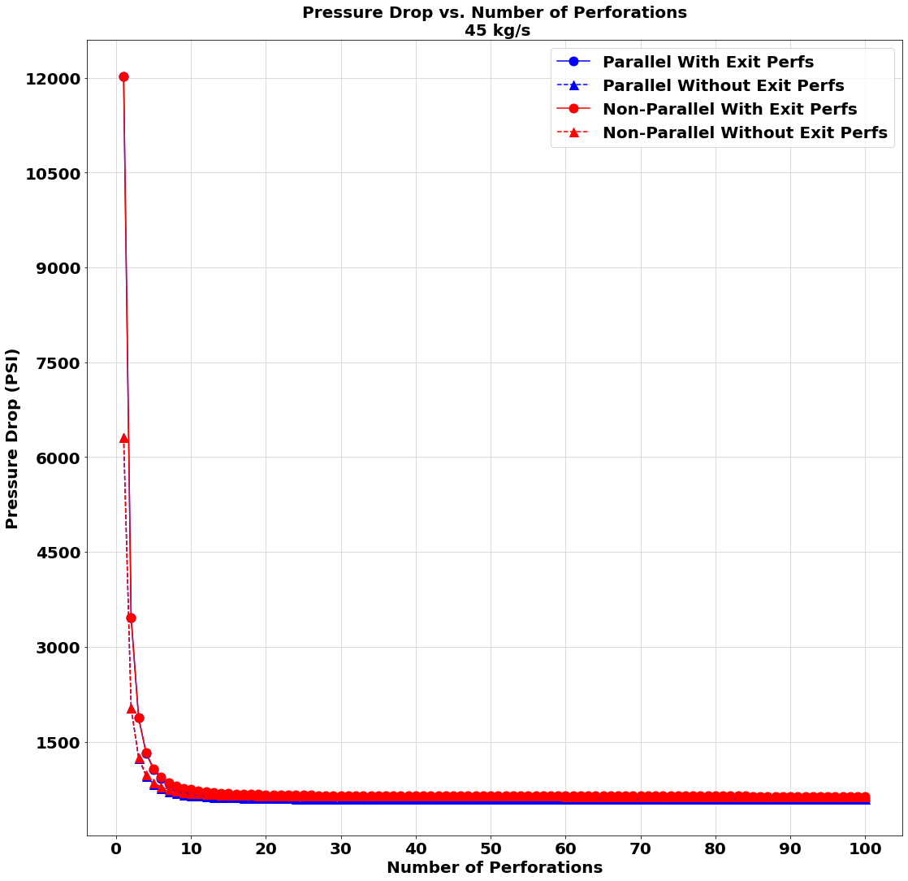
A zoomed-out portion of the third graph on slide 24

Slide 26
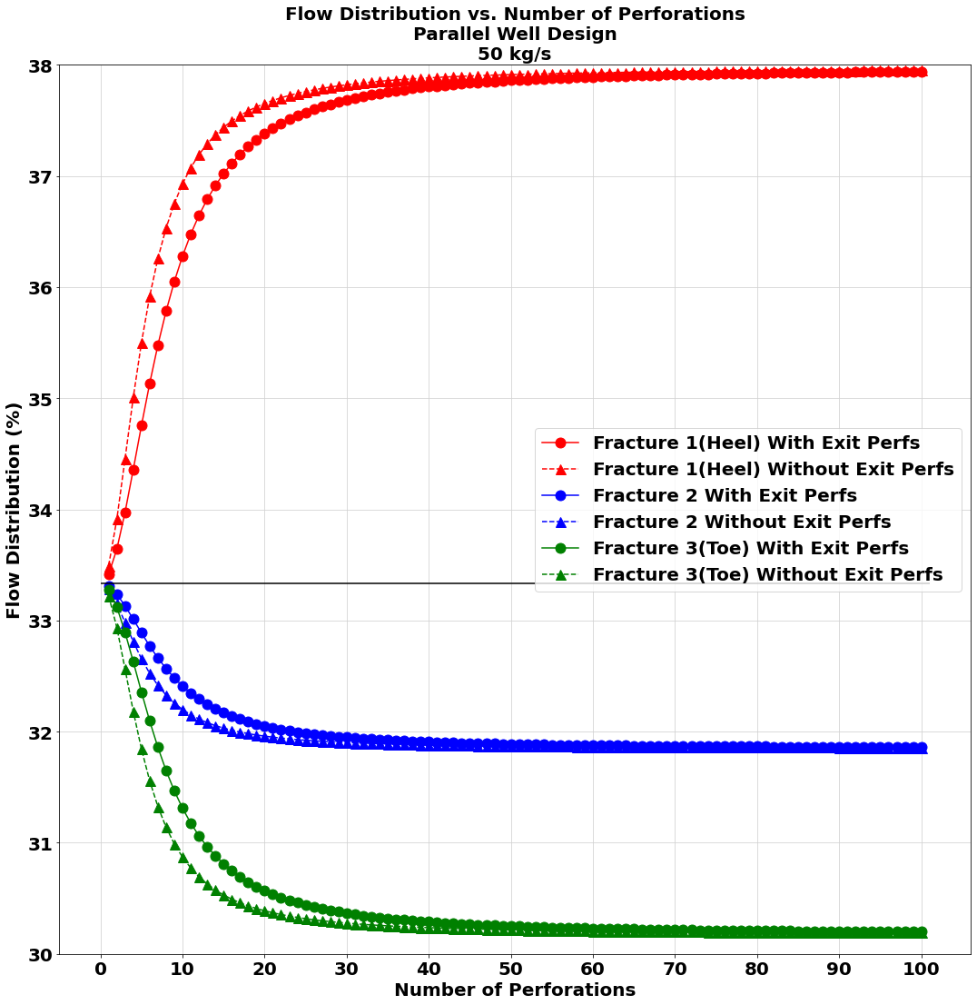
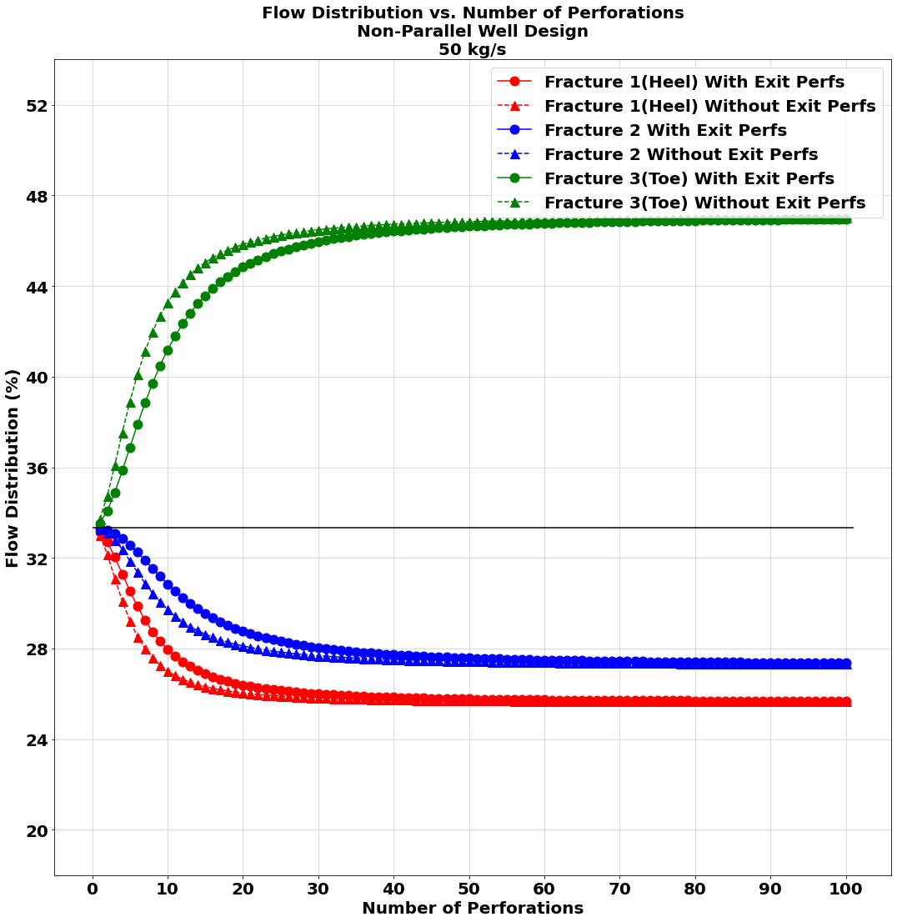
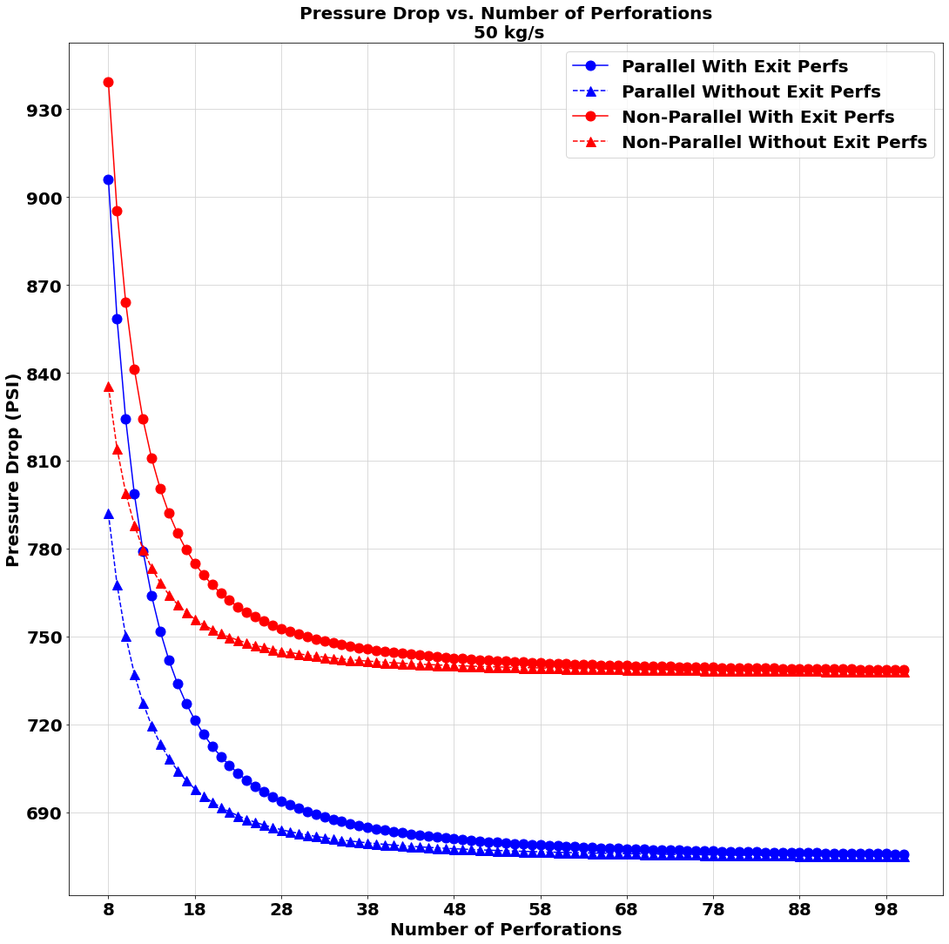
50 kg/s Flowrate Study

Slide 27
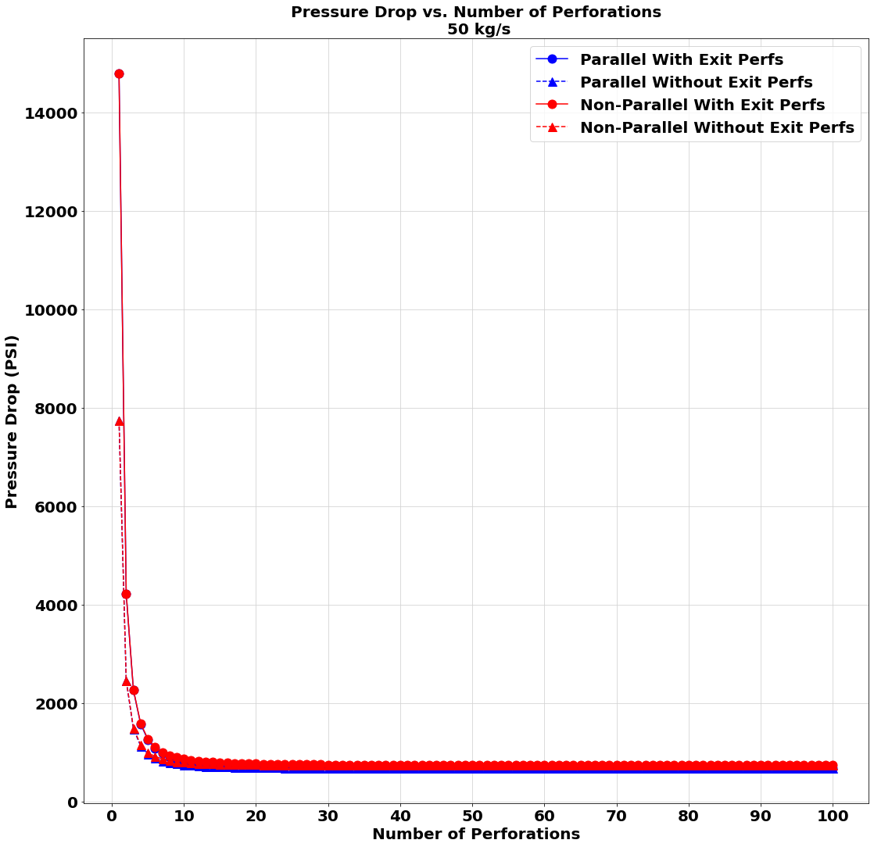
A zoomed-out portion of the third graph on slide 26

Slide 28
Conclusion: Number of Perforations Study/Exit Perforations
At approximately 40 perforations both the pressure drop and flow distribution percentage remains relatively constant.
At approximately 40 perforations both the with and without exit perforation lines are nearly identical
Before 40 perforations is reached, the case without exit perforations had a slightly larger flowrate deviation from the ideal flowrate distribution than the case with exit perforations.

Slide 29
Conclusion: Parallel vs. Non-Parallel
Flow distribution %: The majority flow distribution (> 33.3%) fracture switches from fracture 1 (Heel) to fracture 3 (Toe) with the switch from parallel to non-parallel well designs. This is due to fracture 3 (Toe) being set to be 100 m smaller in length than fracture 1 (Heel) in the non-parallel case, causing more of the flow to flow through the smaller fracture (fracture 3, Heel).
Pressure drop: The parallel well design had a larger pressure drop for flowrates 5 kg/s to 20 kg/s than the non-parallel design. At 20 kg/s, the parallel and non-parallel design had almost identical pressure drops. Past 20 kg/s, the non-parallel well design had a larger pressure drop than the parallel design. At 50 kg/s the non-parallel design had a pressure drop approximately 60 PSI greater than the parallel design. At 5 kg/s the parallel design had a pressure drop approximately 5 PSI greater than the non-parallel well design.

Slide 30
Conclusion: Flowrate Study
Flow distribution %: At 5 kg/s using the parallel well design, the maximum deviation from the ideal flow distribution (>33.3%) is approximately 1% by fracture 1 (Heel).
At 50 kg/s using the parallel well design, the maximum deviation from the ideal flow distribution (>33.3%) is approximately 4.5% by fracture 1 (Heel).
At 5 kg/s using the non-parallel well design, the maximum deviation from the ideal flow distribution (>33.3%) is approximately 19% by fracture 3 (Toe).
At 50 kg/s using the non-parallel well design, the maximum deviation from the ideal flow distribution (>33.3%) is approximately 13% by fracture 3 (Toe).

Slide 31
Conclusion: Flowrate Study
Flow distribution %: At 5 kg/s using the parallel well design, the minimum deviation from the ideal flow distribution (<33.3%) is approximately 0.8% by fracture 3 (Toe).
At 50 kg/s using the parallel well design, the minimum deviation from the ideal flow distribution (<33.3%) is approximately 3% by fracture 3 (Toe).
At 5 kg/s using the non-parallel well design, the minimum deviation from the ideal flow distribution (<33.3%) is approximately 13% by fracture 1 (Heel).
At 50 kg/s using the non-parallel well design, the minimum deviation from the ideal flow distribution (<33.3%) is approximately 7% by fracture 1 (Heel).

Slide 32
Conclusion: Flowrate Study
Pressure drop: The difference of pressure drop for the extreme flowrate cases (5 kg/s and 50 kg/s) is quite large. At 5 kg/s, the maximum pressure drop was approximately 190 PSI for the parallel well design with exit perforations and 1 perforation. At 50 kg/s, the maximum pressure drop was approximately 15,000 PSI for the non-parallel well design with exit perforations and 1 perforation.
Looking at the zoomed in pressure drop chart (starting from 8 perforations), the maximum flowrate had a large difference as well. At 5 kg/s and 8 perforations, the maximum pressure drop was 49.5 PSI for the parallel well design with exit perforations. At 50 kg/s and 8 perforations, the maximum pressure drop was 940 PSI for the non-parallel well design with exit perforations. These large pressure drop disparities suggest that a lower flowrate would minimize pressure drop in the non-parallel case and vice versa for the parallel design

Slide 33
Conclusion: Flowrate Study
There seems to be a correlation with flowrate and the well design choice. For a parallel well design, the lower flowrates are desired as these have the lowest deviation from the ideal flowrate distribution. For a non-parallel well design, the higher flowrates are desired as these have the lowest deviation from the ideal flowrate distribution.
In terms of pressure drop the correlation does not vary as much with well design choice. For both parallel and non-parallel well designs, the lower pressure drop occurs at the lower flowrate.

Slide 34
Conclusion: Flowrate Study
Therefore, for a parallel well design, the ideal design choice would be a 5 kg/s flowrate as this minimizes both pressure drop and deviation from the ideal flowrate percentage.
However, for a non-parallel well design, the ideal design choice could be flowrates ranging from 15 kg/s to 25 kg/s as this minimizes pressure drop. The pressure drop for the higher flowrates was unrealistically too high, so even though 15 kg/s through 25 kg/s does not minimize deviation from the ideal flowrate distribution, it is still the ideal choice.

Slide 35
First Study, Third Study, Fourth Study
Varying Number of Perforations (1-60)
Varying Inlet Flowrate (5 to 30 kg/s) --> Math Domain Error with larger than 30 kg/s with 1e-14 m² case
Varying Fracture Permeability (1e-12 m² or 1e-14 m²)

Slide 36
Analytical Model Parameters
Permeability | 1e-12 m² or 1e-14 m²
Number of Fractures | 3
Mass Flow rate | 5 to 30 kg/s (steps of 5 kg/s)
Water Density | 1000 kg/m³
Gravity Constant | 9.8 m/s²
Discharge Coefficient | 0.75
Injection Pressure | 3*10⁷ Pascals
Total Well Length | 3227 m
Roughness of Pipe | 1.5*10⁻⁵ m
Fracture Height | 100 m
Fracture Width | 5 m
Base Fracture Length | 100 m
Diameter Injection/Production Pipes | 0.18 m
Number of Perforations | 1 to 60 (steps of 1)
Base Diameter of Perforations | 0.009525 m (3/8 in)

Slide 37
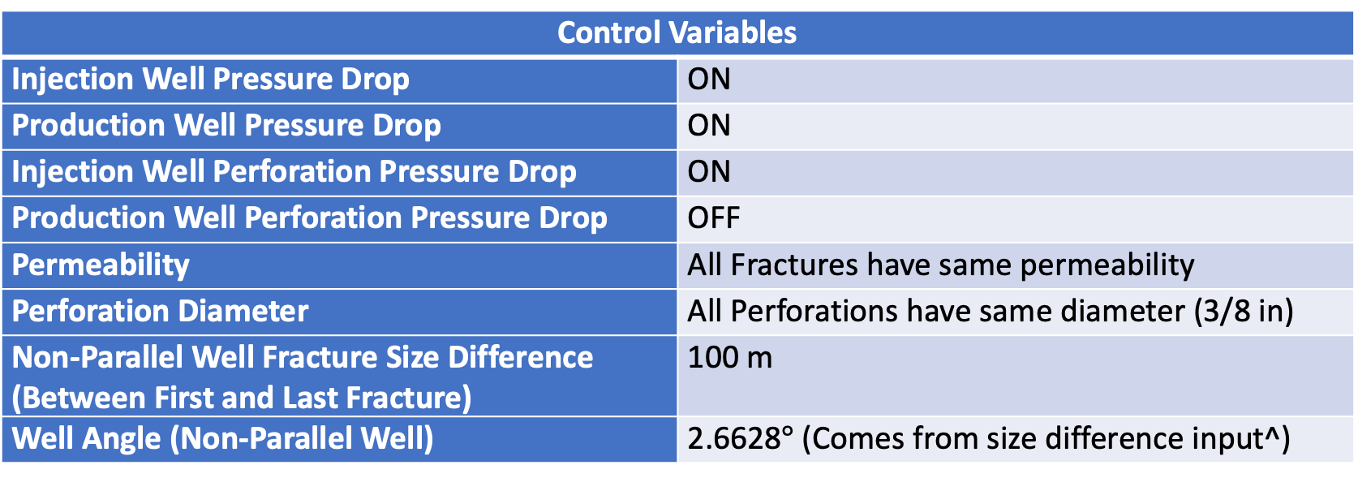
Control Variables
Injection Well Pressure Drop | ON
Production Well Pressure Drop | ON
Injection Well Perforation Pressure Drop | ON
Production Well Perforation Pressure Drop | OFF
Permeability | All Fractures have same permeability
Perforation Diameter | All Perforations have same diameter (3/8 in)
Non-Parallel Well Fracture Size Difference (Between First and Last Fracture) | 100 m
Well Angle (Non-Parallel Well) | 2.6628$°$ (Comes from size difference input^)
Parallel Well Design
Non-Parallel Well Design

Slide 38
Nomenclature
Fracture 1 = Fracture nearest Heel of Well
Fracture 3 = Fracture nearest Toe of Well
1e-12 m²
1e-14 m²
Flowchart representing workings of analytical model

Slide 39
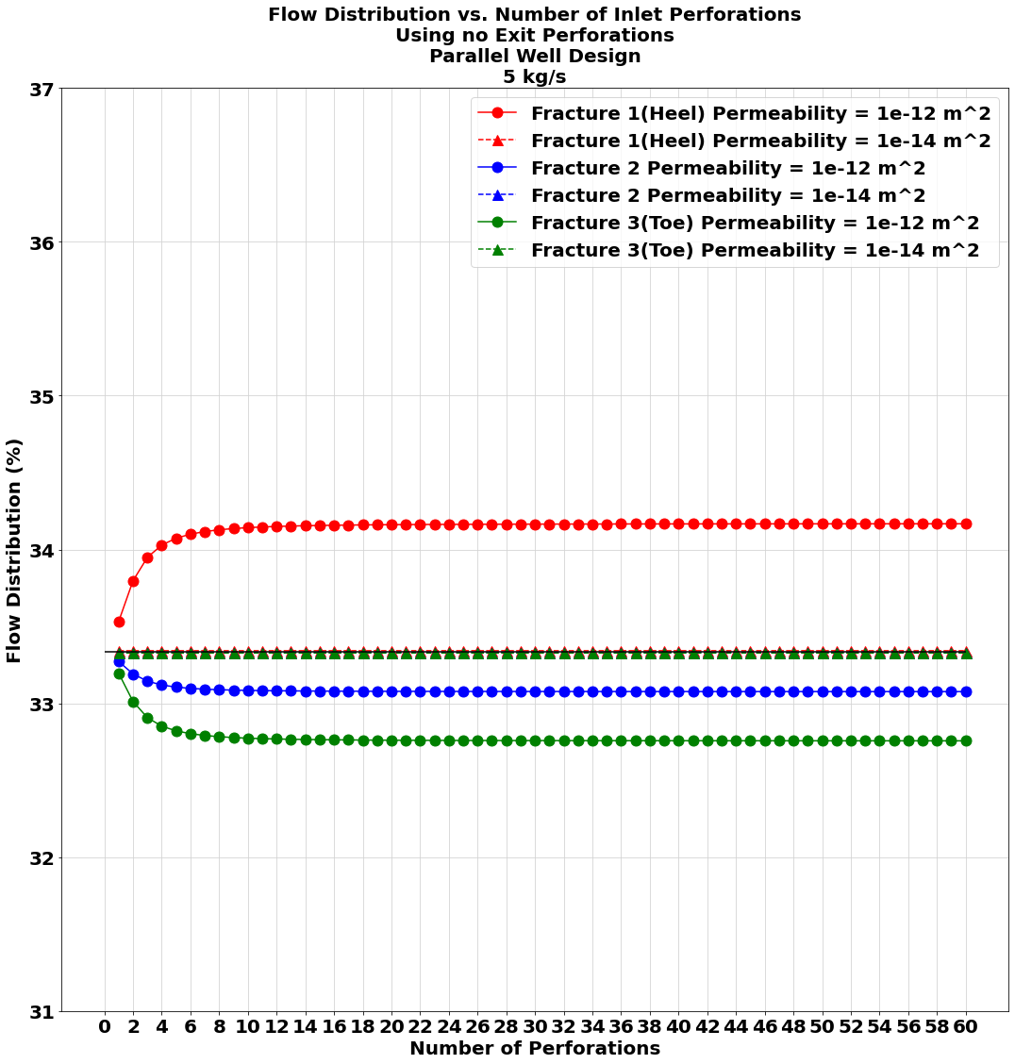
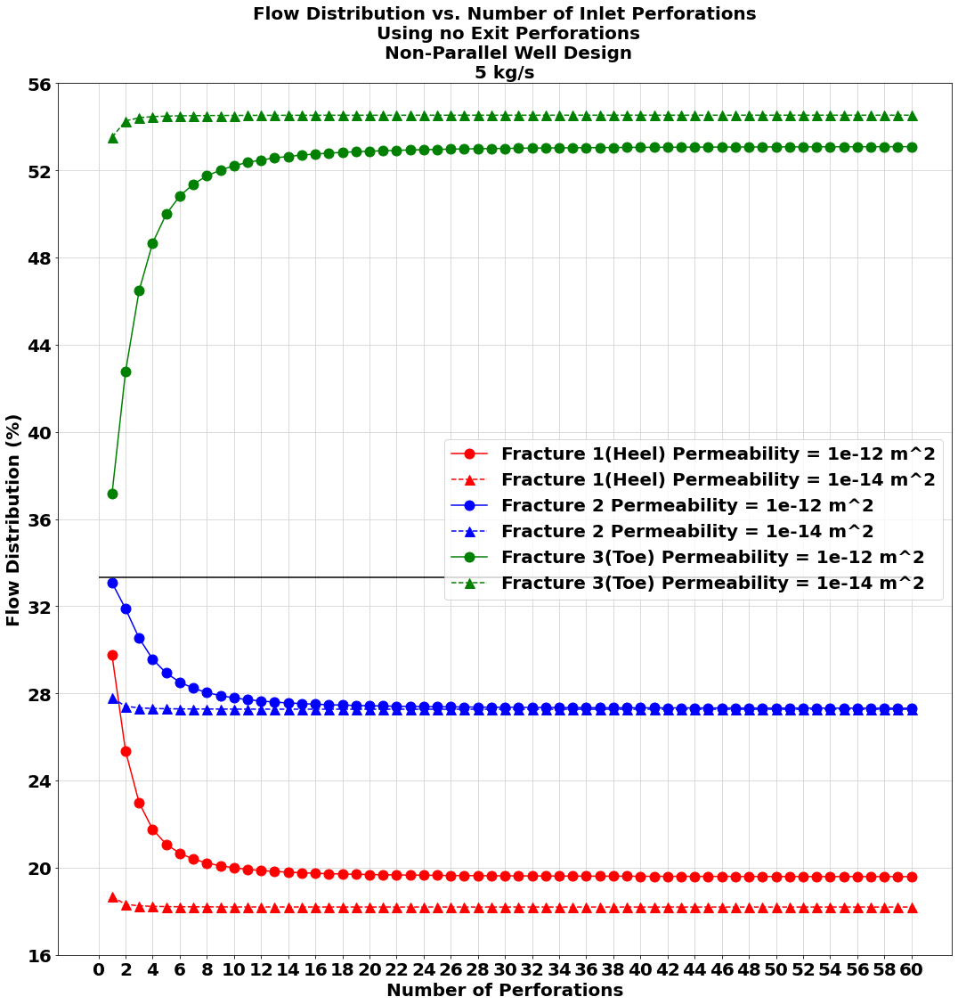

5 kg/s Flowrate Study

Slide 40



10 kg/s Flowrate Study

Slide 41



15 kg/s Flowrate Study

Slide 42



20 kg/s Flowrate Study

Slide 43



25 kg/s Flowrate Study

Slide 44



30 kg/s Flowrate Study

Slide 45
Conclusion: Permeability Study
For the Parallel well design, the lower permeability value of 1e-14 m² yielded a nearly perfect flow distribution percentage across all fractures, however, this permeability value yielded unrealistically high pressure drops.
For the Non-Parallel well design, the lower permeability value of 1e-14 m² yielded slightly worse flow distribution than the higher permeability value of 1e-12 m². The pressure drop was still unrealistically high for the lower permeability value of 1e-14 m².

Slide 46
Conclusion: Permeability Study
The flowrate studies suggests that no matter the flowrate, the pressure drop will always be unrealistically high for a lower permeability value of 1e-14 m².
Even though in the parallel case the flow distribution percentage was nearly perfect for the lower permeability value of 1e-14 m², the pressure drop values suggest this permeability value is not feasible for a good EGS design.

Slide 47
Third Study and Fifth Study
Varying Inlet Flowrate (5 to 50 kg/s)
Varying Well Angle (Non-Parallel Design)

Slide 48
Analytical Model Parameters
Permeability | 1e-12 m²
Number of Fractures | 3
Mass Flow rate | 5 to 50 kg/s (steps of 5 kg/s)
Water Density | 1000 kg/m³
Gravity Constant | 9.8 m/s²
Discharge Coefficient | 0.75
Injection Pressure | 3*10⁷ Pascals
Total Well Length | 3227 m
Roughness of Pipe | 1.5*10⁻⁵ m
Fracture Height | 100 m
Fracture Width | 5 m
Base Fracture Length | 100 m
Diameter Injection/Production Pipes | 0.18 m
Number of Perforations | 50
Base Diameter of Perforations | 0.009525 m (3/8 in)

Slide 49

Control Variables
Injection Well Pressure Drop | ON
Production Well Pressure Drop | ON
Injection Well Perforation Pressure Drop | ON
Production Well Perforation Pressure Drop | OFF
Permeability | All Fractures have same permeability
Perforation Diameter | All Perforations have same diameter (3/8 in)
Non-Parallel Well Fracture Size Difference (Between First and Last Fracture) | Varying Depending on Well Angle
Well Angle (Non-Parallel Well) | 0.1$°$ to 115$°$ (steps of 0.1$°$)
Parallel Well Design
Non-Parallel Well Design

Slide 50
Nomenclature
Fracture 1 = Fracture nearest Heel of Well
Fracture 3 = Fracture nearest Toe of Well
Flowchart representing workings of analytical model

Slide 51


5 kg/s Flowrate Well Angle Study

Slide 52


5 kg/s Flowrate Well Angle Study

Slide 53


10 kg/s Flowrate Well Angle Study

Slide 54


10 kg/s Flowrate Well Angle Study

Slide 55


15 kg/s Flowrate Well Angle Study Study

Slide 56


15 kg/s Flowrate Well Angle Study Study

Slide 57


20 kg/s Flowrate Well Angle Study

Slide 58


20 kg/s Flowrate Well Angle Study

Slide 59


25 kg/s Flowrate Well Angle Study

Slide 60


25 kg/s Flowrate Well Angle Study

Slide 61


30 kg/s Flowrate Well Angle Study

Slide 62


30 kg/s Flowrate Well Angle Study

Slide 63


35 kg/s Flowrate Well Angle Study

Slide 64


35 kg/s Flowrate Well Angle Study

Slide 65


40 kg/s Flowrate Well Angle Study

Slide 66


40 kg/s Flowrate Well Angle Study

Slide 67


45 kg/s Flowrate Well Angle Study

Slide 68


45 kg/s Flowrate Well Angle Study

Slide 69


50 kg/s Flowrate Well Angle Study

Slide 70


50 kg/s Flowrate Well Angle Study

Slide 71


Fracture Length = Fracture Length Difference + Base Fracture Length (100 m)

Slide 72

Conclusion: Well Angle Study
The studies suggest that there is an ideal well angle scenario between 0$°$ and 5$°$, where the flow distribution is close to the ideal distribution (33.3%) and the pressure drop remains low enough to be deemed feasible.
The closer the angle approaches to 5$°$, the closer the flow distribution approaches a local maximum that varies from approximately 75% of the flow for the 50 kg/s case and approximately 95% of the flow for the 5 kg/s. These local maximum are occurring at Fracture 3 or near the toe of the well.

Slide 73

Conclusion: Well Angle Study
At this local maximum at approximately 5$°$, the pressure drop reaches a local minimum value then begins increasing, suggesting that in order to have a low pressure drop, a well angle less than 5$°$ is a necessity.
The closest the well angle can get to 0$°$, the closer the flowrate distribution is to the ideal distribution, and the lower the pressure drop. Making a smaller well angle the ideal design choice for a Non-Parallel well design.

Slide 74
Third Study and Sixth Study
Varying Inlet Flowrate (5 to 50 kg/s)
Varying Number of Fractures with 1 Inlet Perforation
Used only parallel design

Slide 75
Analytical Model Parameters
Permeability | 1e-12 m²
Number of Fractures | 1 to 30 (steps of 1)
Mass Flow rate | 5 to 50 kg/s (steps of 5 kg/s)
Water Density | 1000 kg/m³
Gravity Constant | 9.8 m/s²
Discharge Coefficient | 0.75
Injection Pressure | 3*10⁷ Pascals
Total Well Length | 3227 m
Roughness of Pipe | 1.5*10⁻⁵ m
Fracture Height | 100 m
Fracture Width | 5 m
Base Fracture Length | 100 m
Diameter Injection/Production Pipes | 0.18 m
Number of Perforations | 1
Base Diameter of Perforations | 0.009525 m (3/8 in)

Slide 76

Control Variables
Injection Well Pressure Drop | ON
Production Well Pressure Drop | ON
Injection Well Perforation Pressure Drop | ON
Production Well Perforation Pressure Drop | OFF
Permeability | All Fractures have same permeability
Perforation Diameter | All Perforations have same diameter (3/8 in)
Non-Parallel Well Fracture Size Difference (Between First and Last Fracture) | N/A (only used parallel design)
Well Angle (Non-Parallel Well) | 0$°$
Parallel Well Design
Non-Parallel Well Design

Slide 77


Zoomed in plot
←
Pressure Drop vs. Number of Fractures

Slide 78


5 kg/s Flowrate Study

Slide 79


10 kg/s Flowrate Study

Slide 80


15 kg/s Flowrate Study

Slide 81


20 kg/s Flowrate Study

Slide 82


25 kg/s Flowrate Study

Slide 83


30 kg/s Flowrate Study

Slide 84


35 kg/s Flowrate Study

Slide 85


40 kg/s Flowrate Study

Slide 86


45 kg/s Flowrate Study

Slide 87


50 kg/s Flowrate Study

Slide 88

Pressure Drop Difference

Slide 89
Conclusion: Number of Fractures Study
The flowrate study plots show that as the number of fractures increases, the pressure drop exhibits asymptotic behavior and approaches a constant value past approximately 10 fractures. This holds true for all flowrates tested.
At smaller number of fracture zones, the pressure drop can vary greatly depending on the flowrate. At 50 kg/s the maximum pressure drop achieved by 1 fracture zone is approximately 64,000 PSI. While at 5 kg/s, the maximum pressure drop achieved by 1 fracture zone is approximately 770 PSI.

Slide 90
Conclusion: Number of Fractures Study
This relationship suggests that at lower flowrates, the lower number of fractures does not yield a unrealistically high pressure drop, opposite from the higher flowrate cases.
For the current design of 3 fracture zones, the lower flowrate would yield a lower pressure drop than the higher flowrate cases.
This study does suggest however, that at higher number of fractures, the pressure drop is still relatively small for all flowrates.
For the 50 kg/s case, a constant value of approximately 350 PSI is approached past about 25 fractures.
For the 5 kg/s case, a constant value of approximately 20 PSI is approaches past about 10 fractures

Slide 91
Conclusion: Number of Fractures Study
A constant value is approached for all of the flowrate cases, however, the number of fractures where this constant value is reached transitions from 10 fractures for the 5 kg/s case and 25 fractures for the 50 kg/s case.

Slide 92
Works Cited
Asai, Pranay, et al. “Analytical Model for Fluid Flow Distribution in an
Enhanced Geothermal Systems (EGS).” Renewable Energy, vol.
193, 18 May 2022, pp. 821–831.,
https://doi.org/10.1016/j.renene.2022.05.079.
Mohammedzain, Ali. “Perforation in Oil Well | Download Scientific Diagram.”
ResearchGate, Mar. 2018, https://researchgate.net/figure/Perforation
-in-oil- well_fig2_333210318.
Olasolo, P., et al. “Enhanced Geothermal Systems (EGS): A Review.”
Renewable and Sustainable Energy Reviews, vol. 56, 2016, pp.
133–144., https://doi.org/10.1016/j.rser.2015.11.031.

Slide 93
END

